Slide 1
Our School through Time
1939 - 2019

Slide 2
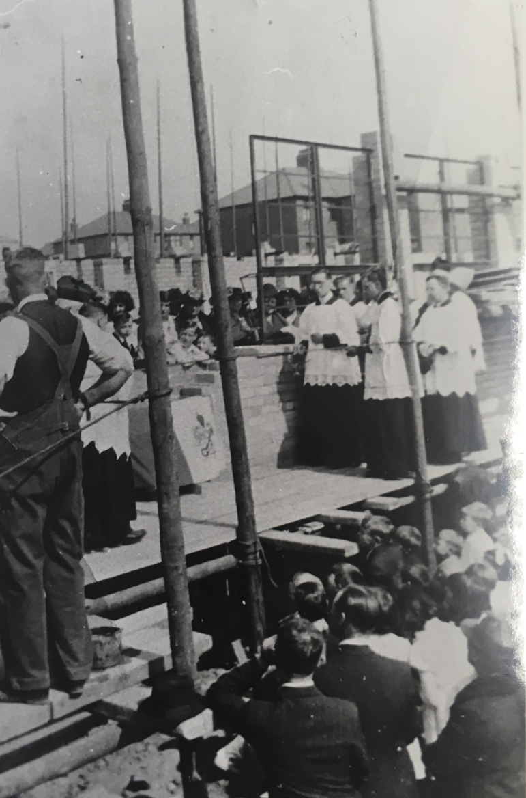
Blessing our school building

Slide 3
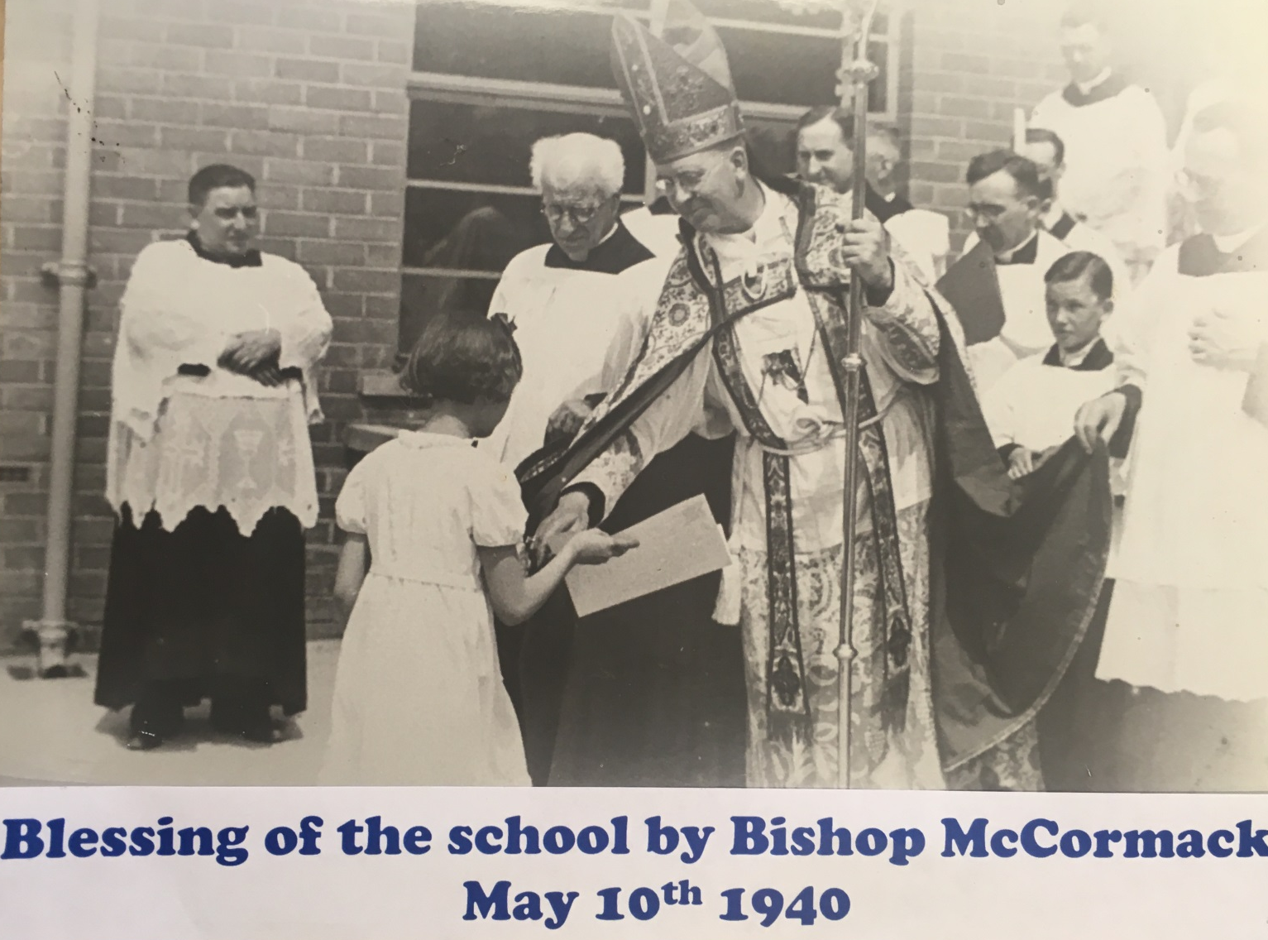

Slide 4
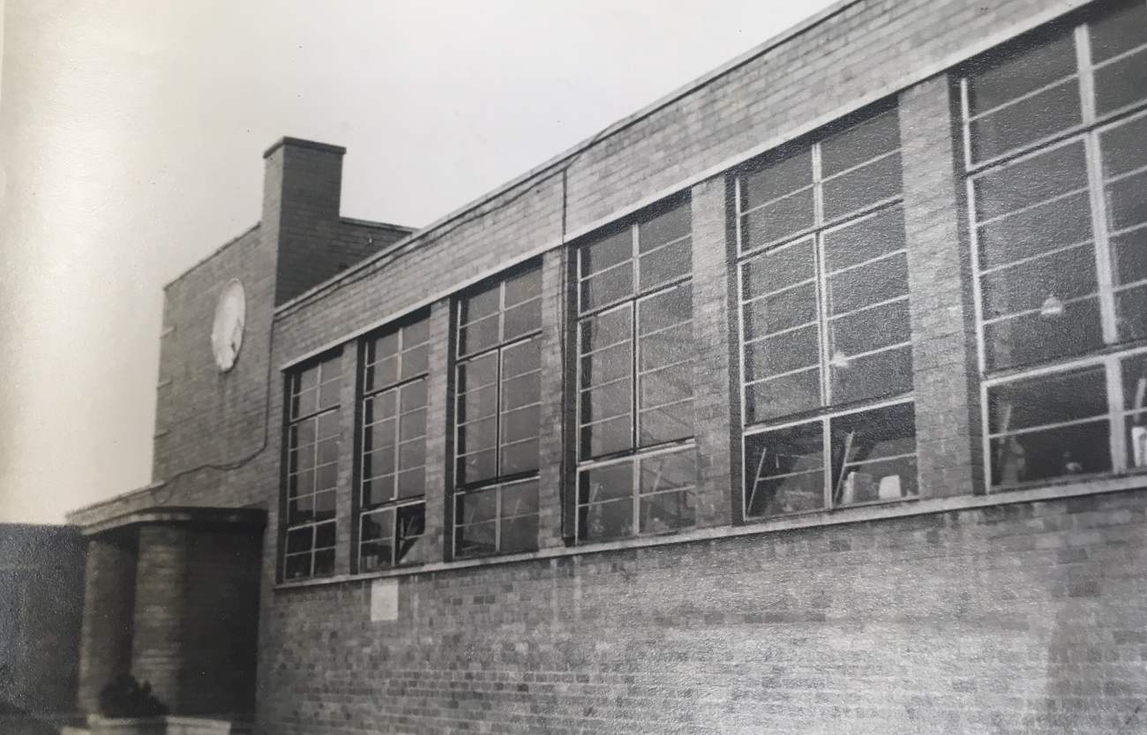
In the beginning…

Slide 5
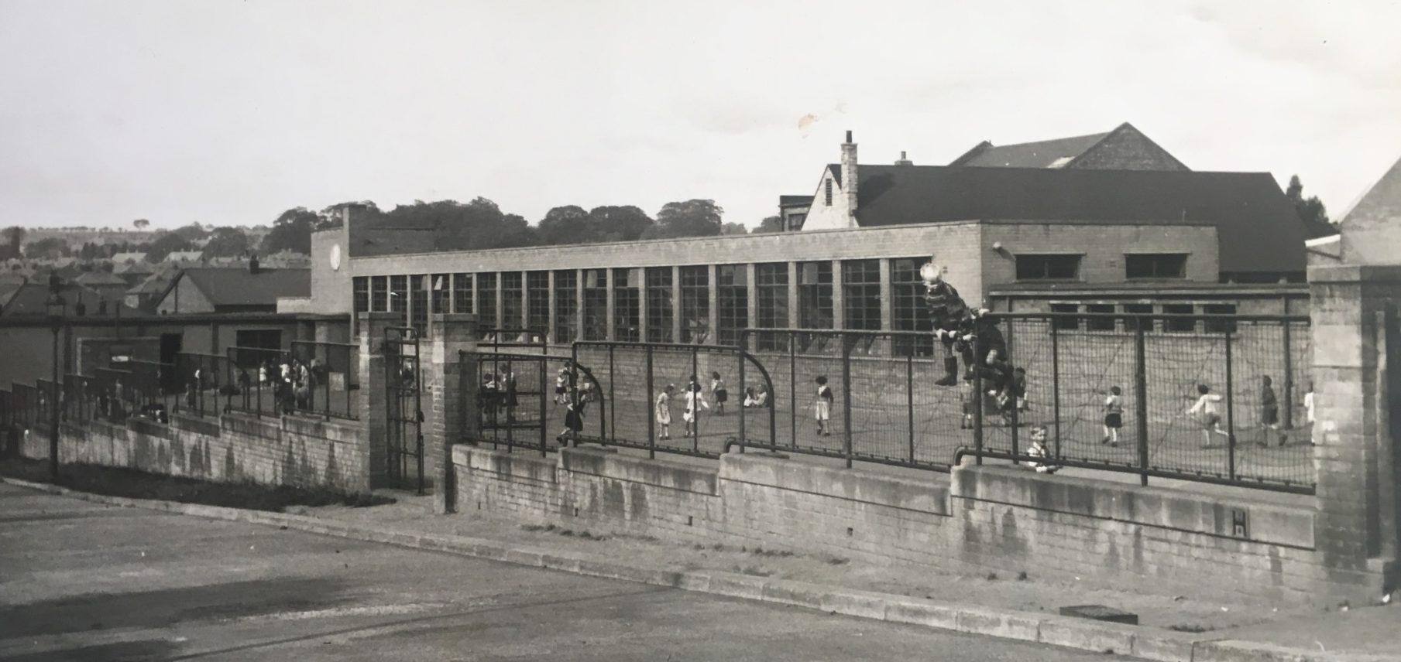
In the beginning …

Slide 6
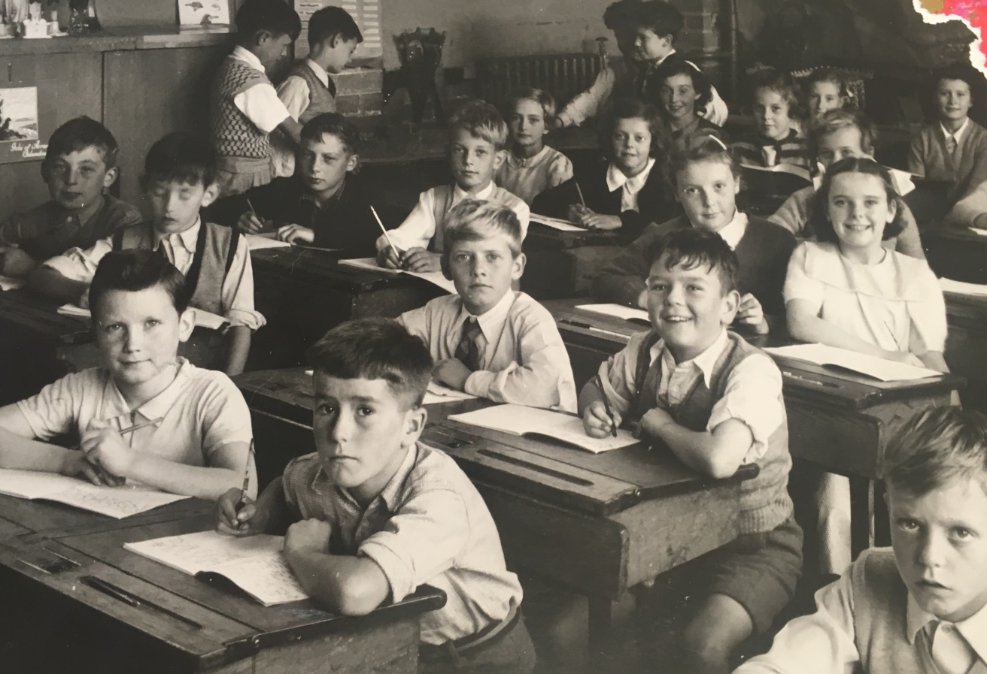
In the beginning …

Slide 7
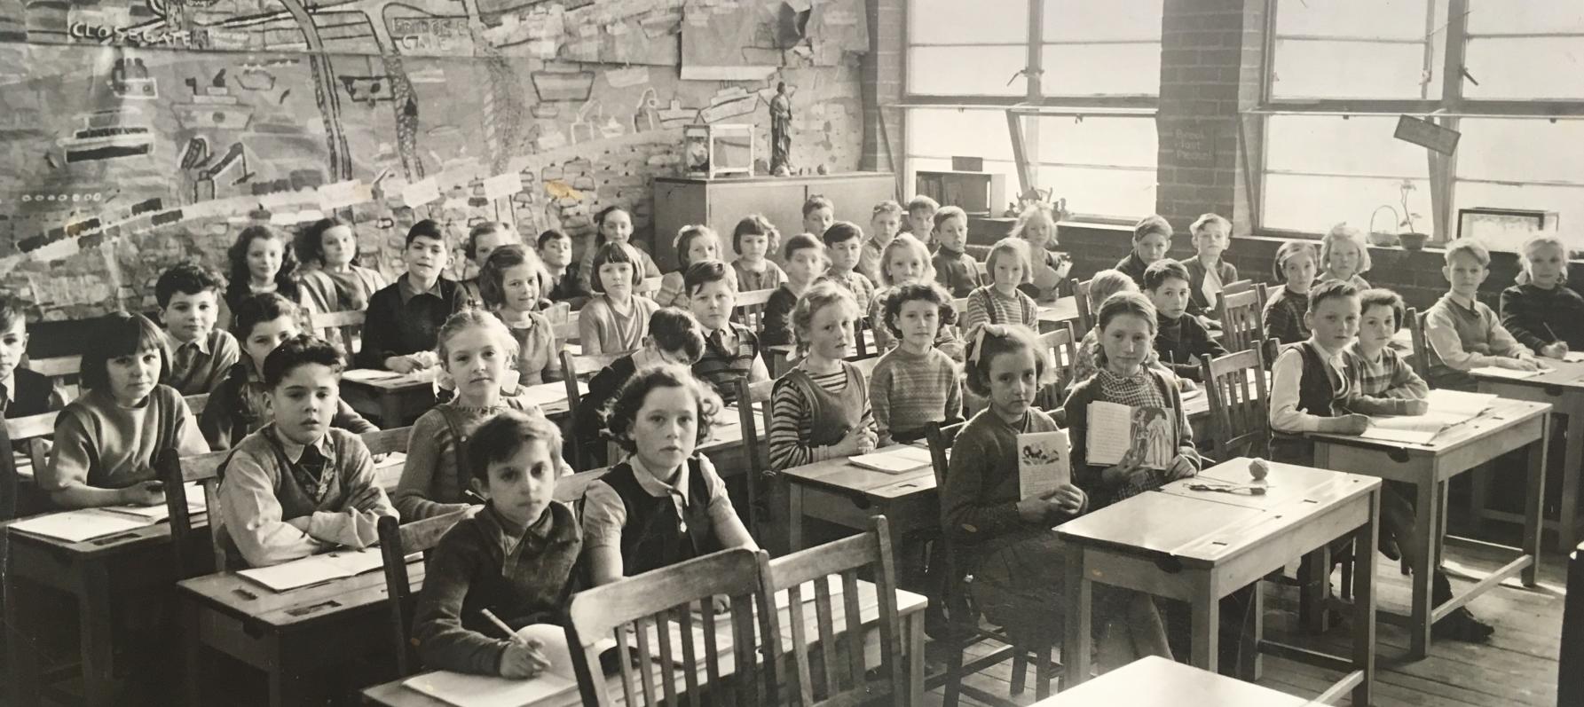
In the beginning …

Slide 8
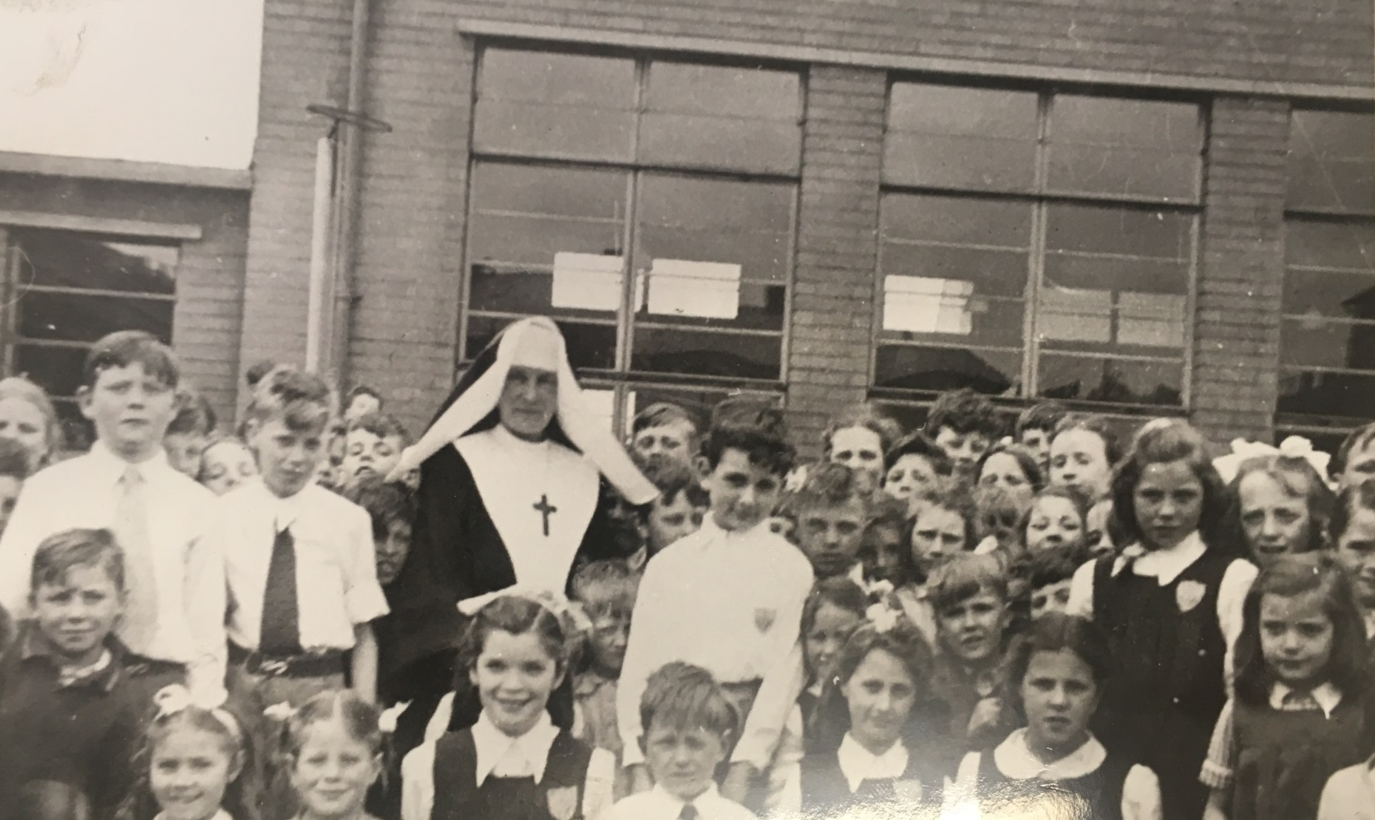
In the beginning …

Slide 9
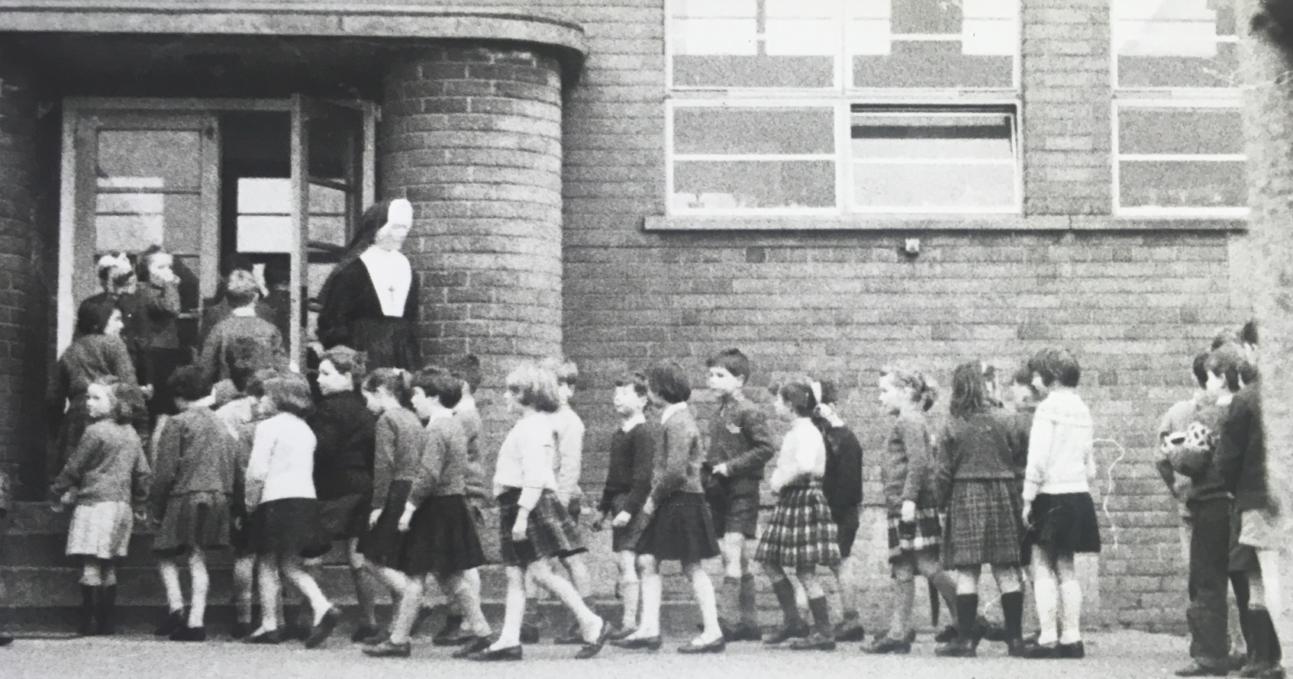
In the beginning …

Slide 10
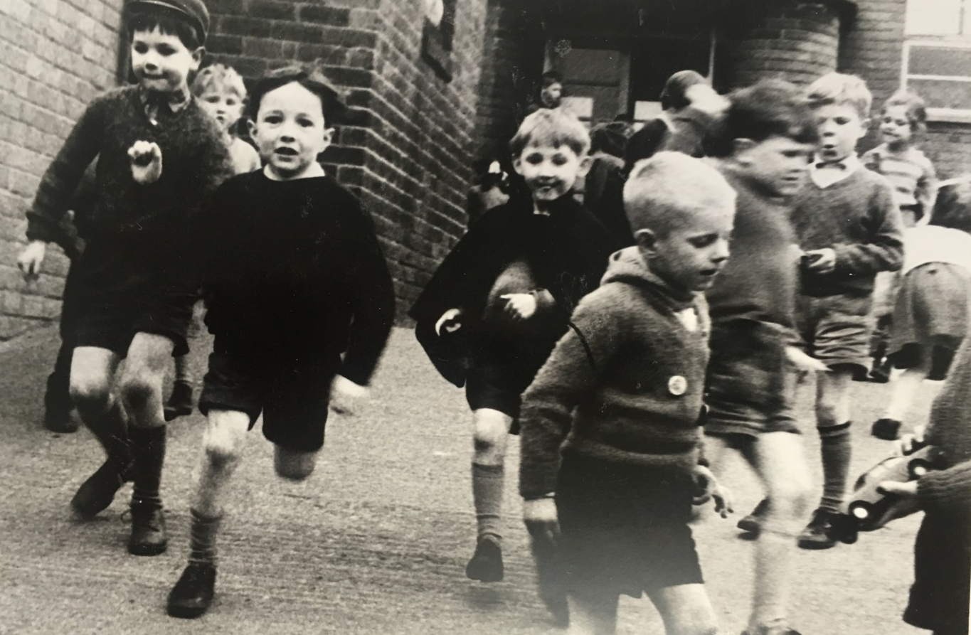
In the beginning …

Slide 11
In the beginning …

Slide 12
The first register 1939

Slide 13
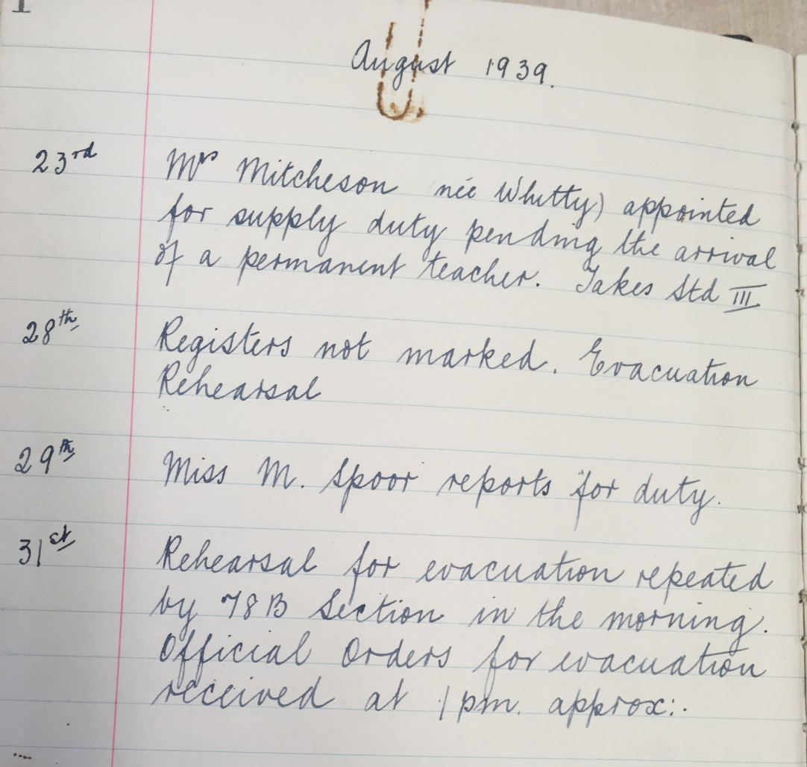
In the beginning …

Slide 14
In the beginning …

Slide 15
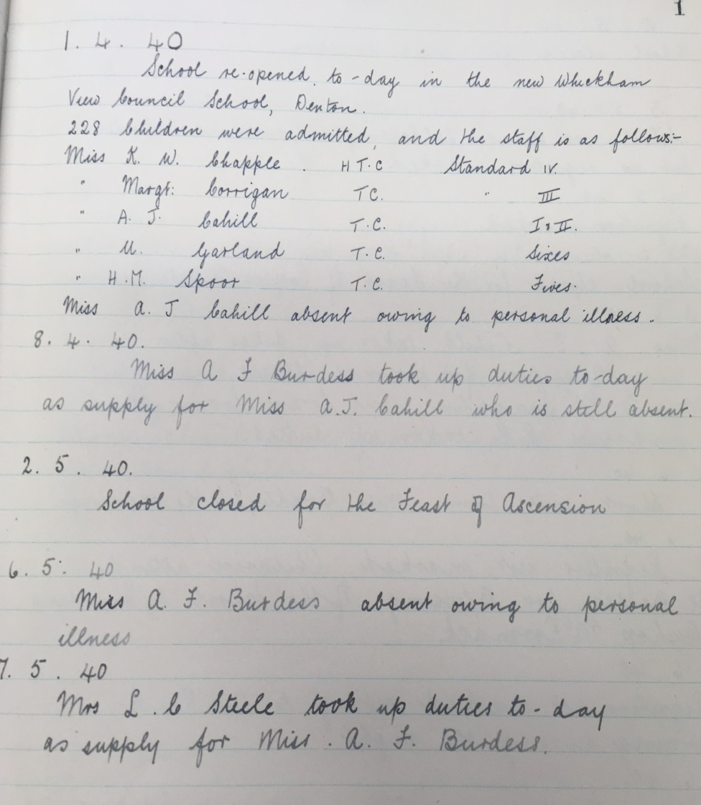
In the beginning …

Slide 16
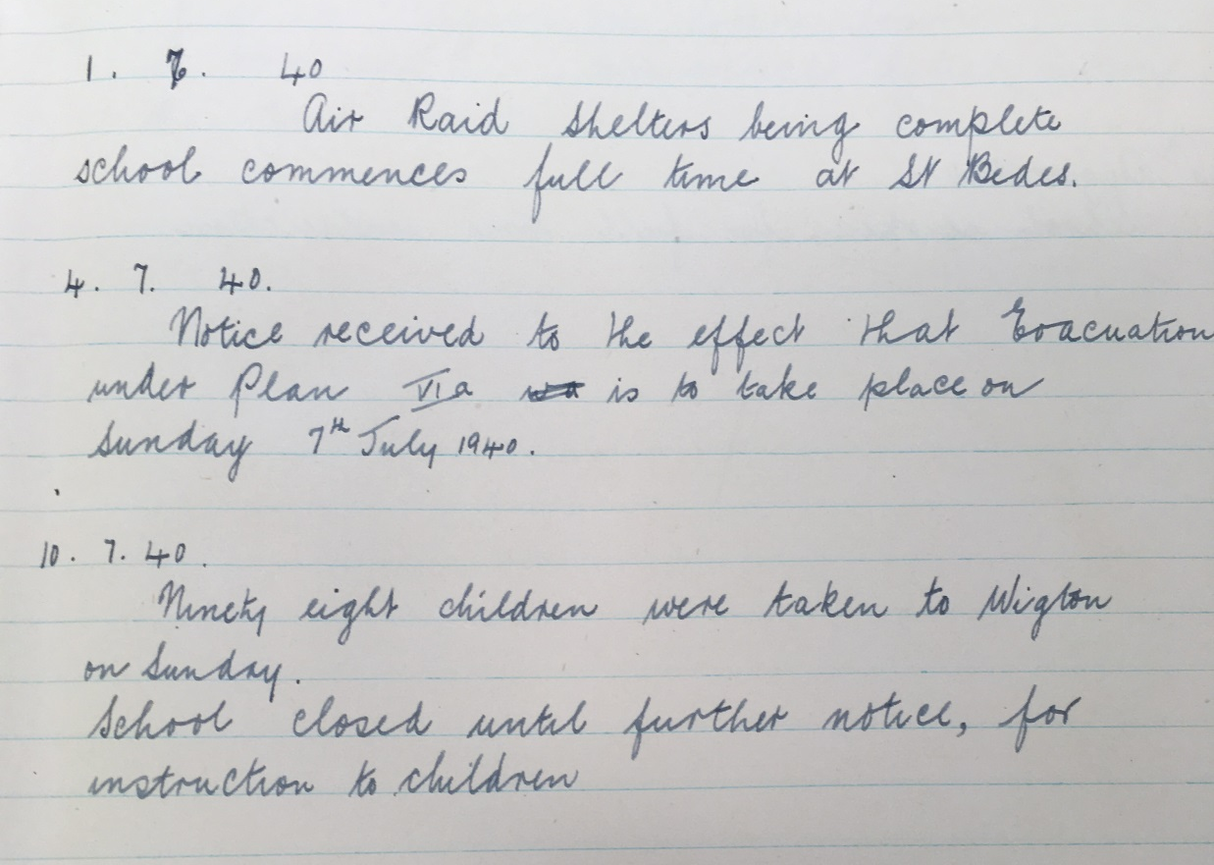
In the beginning …

Slide 17
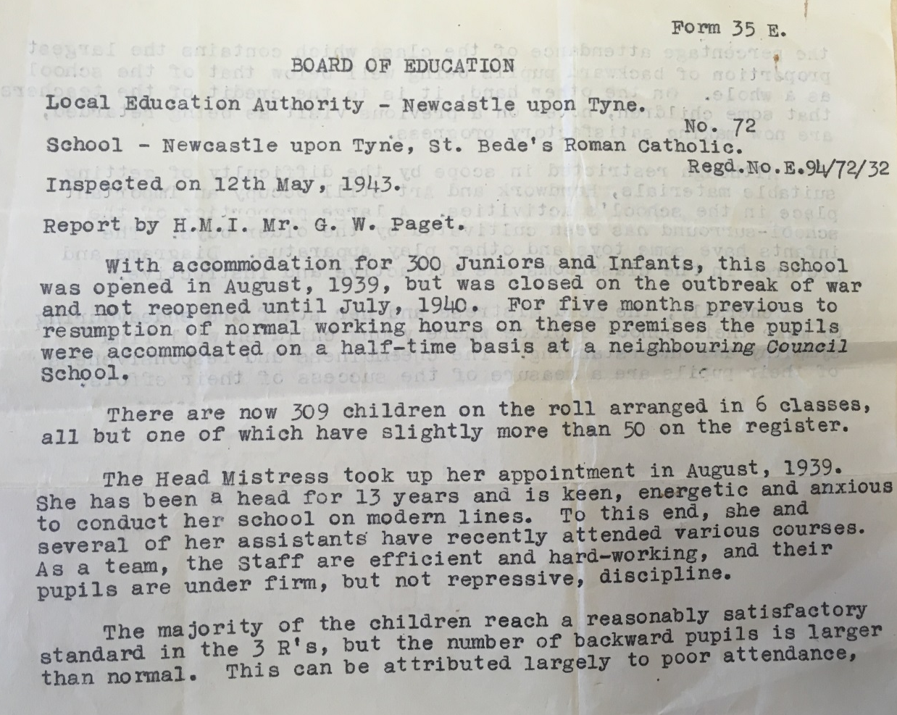
School Inspection report 1943 …

Slide 18
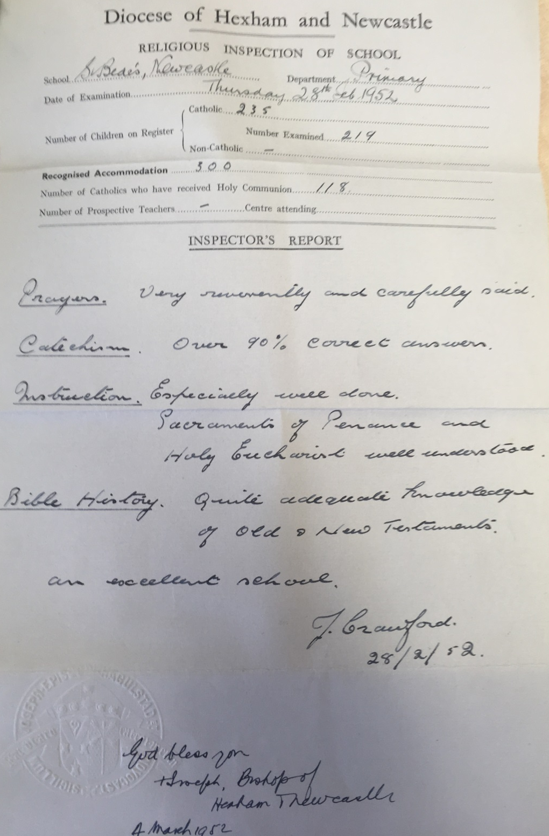
RE Inspection report 1952 …

Slide 19
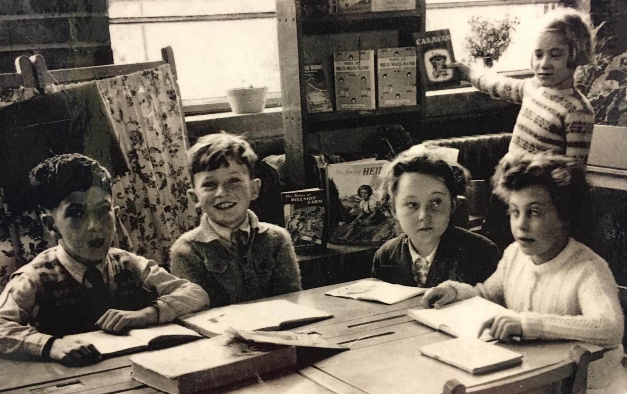
In the beginning …

Slide 20
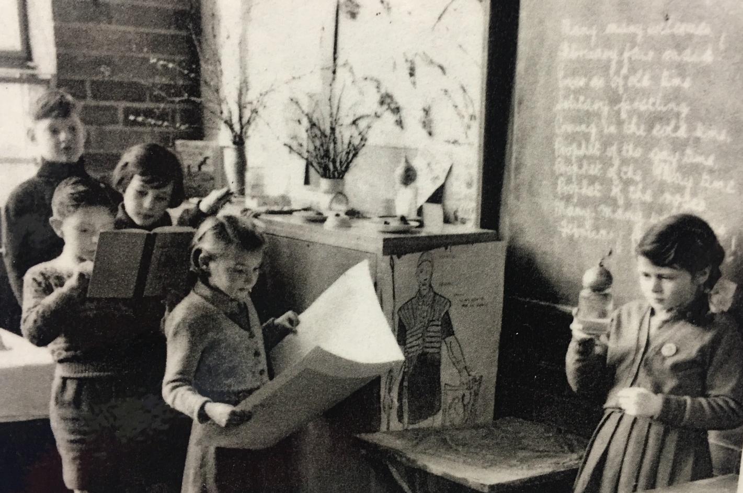
In the beginning …

Slide 21
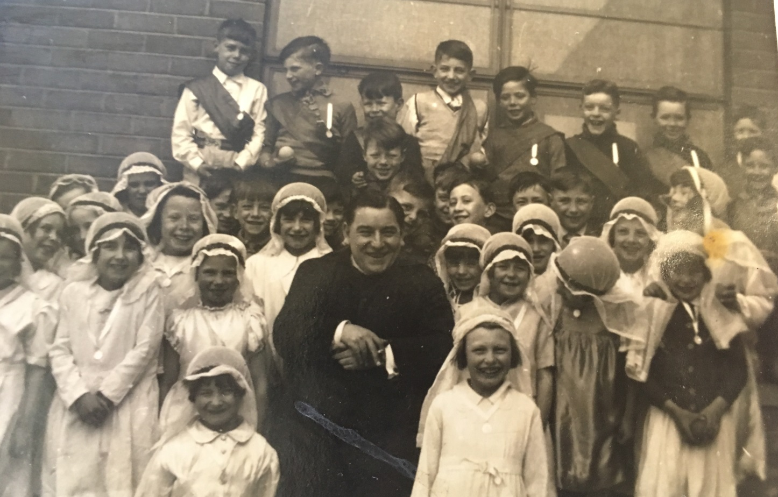
In the beginning …

Slide 22
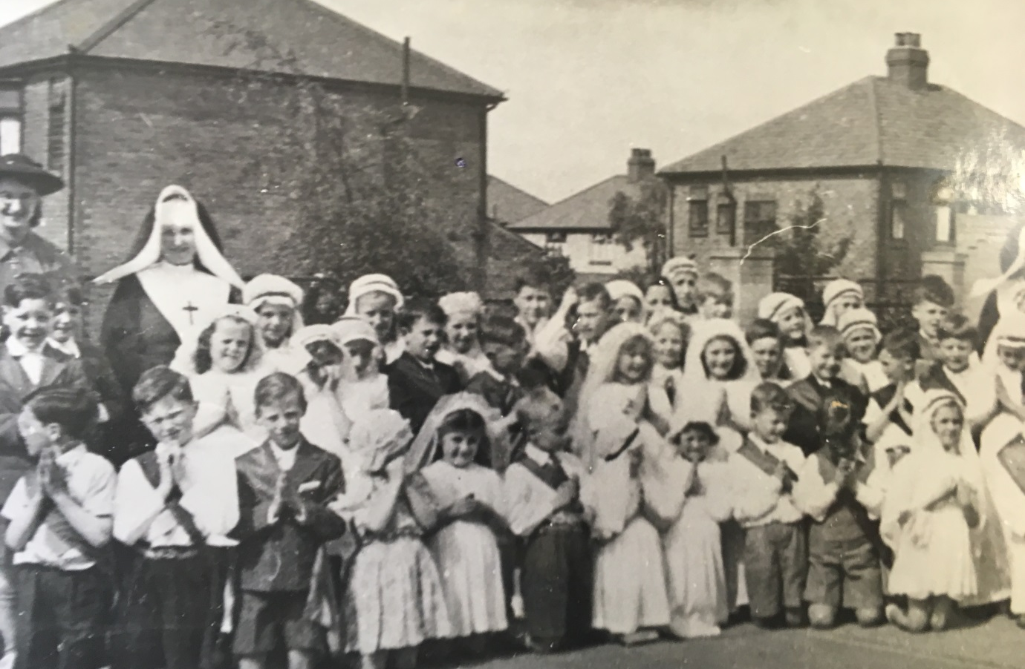
In the beginning …

Slide 23
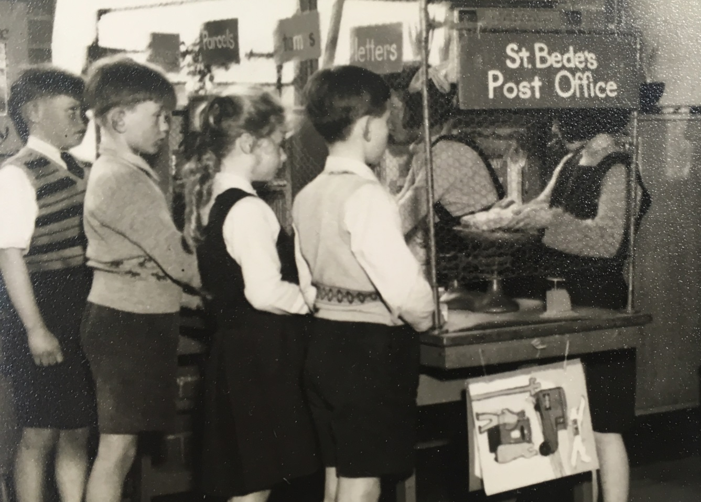
In the beginning …

Slide 24
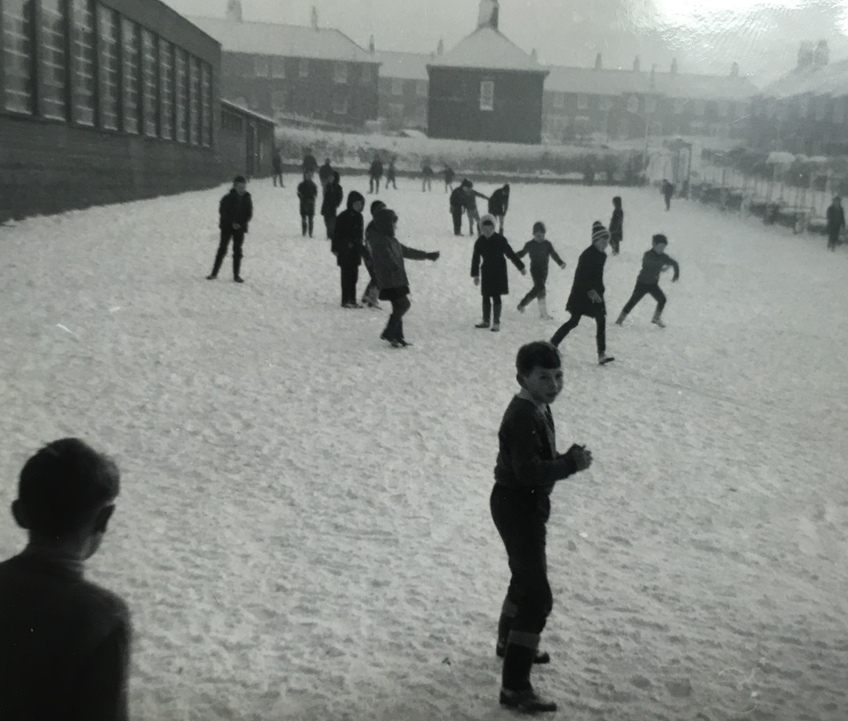
In the beginning …

Slide 25
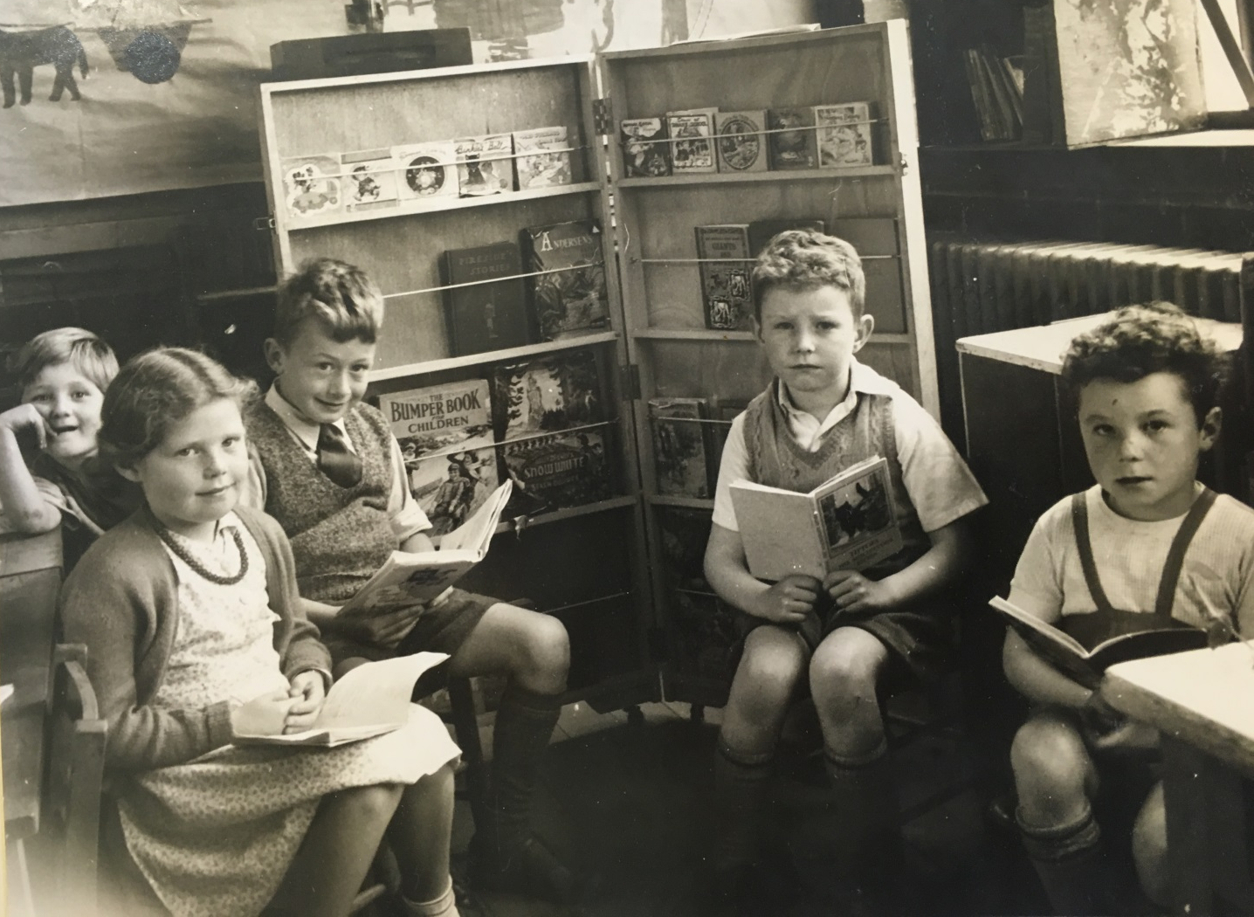
In the beginning …

Slide 26
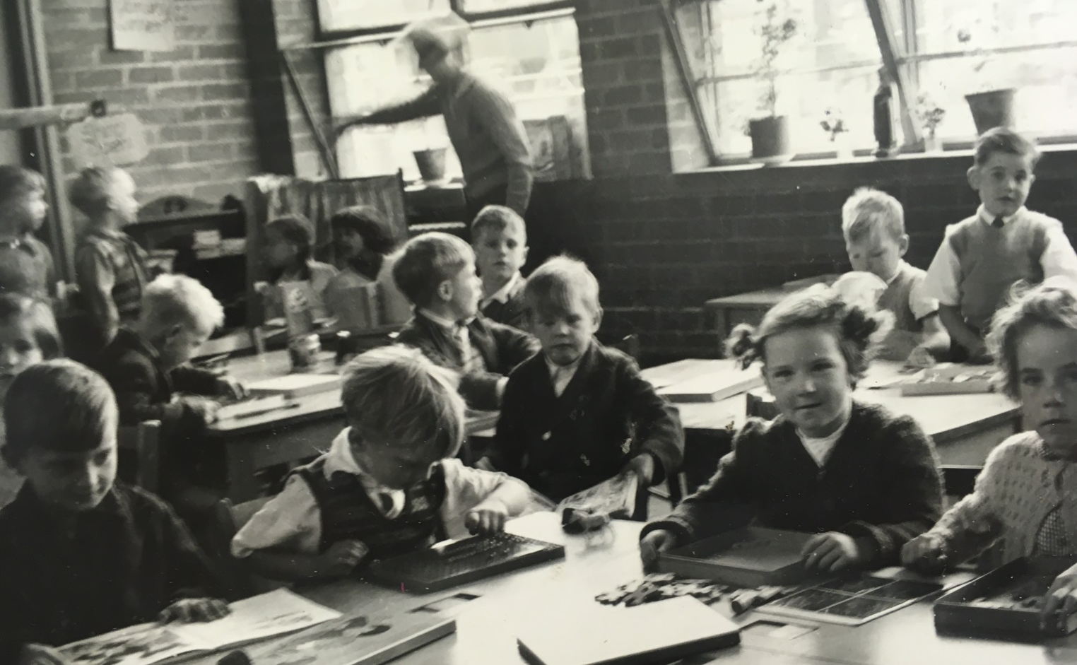
In the beginning …

Slide 27
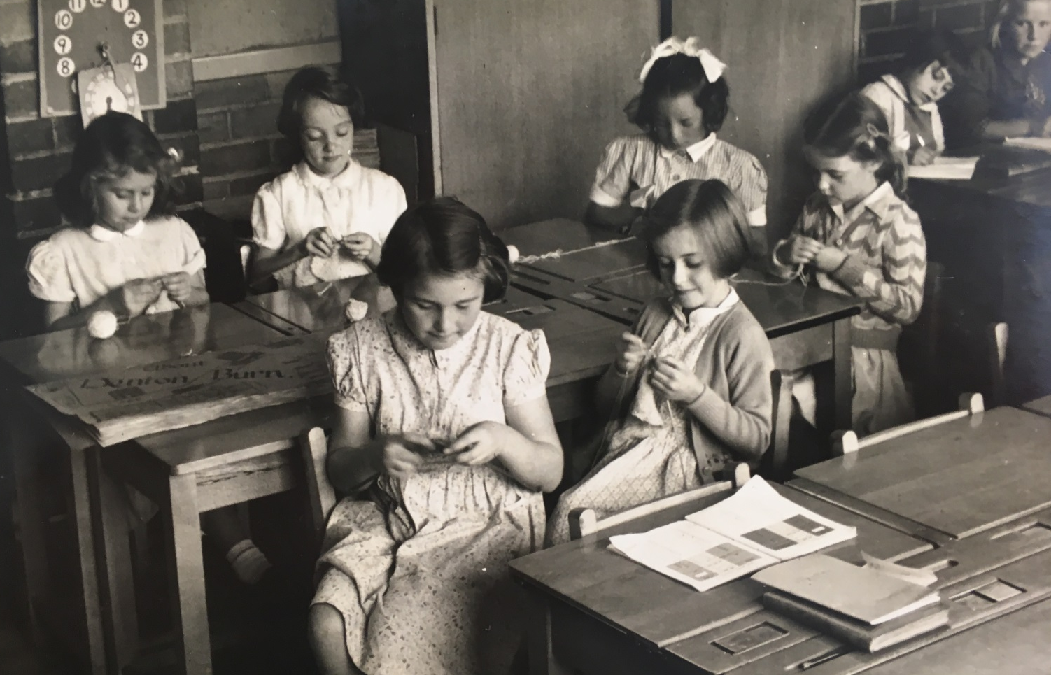
In the beginning …

Slide 28
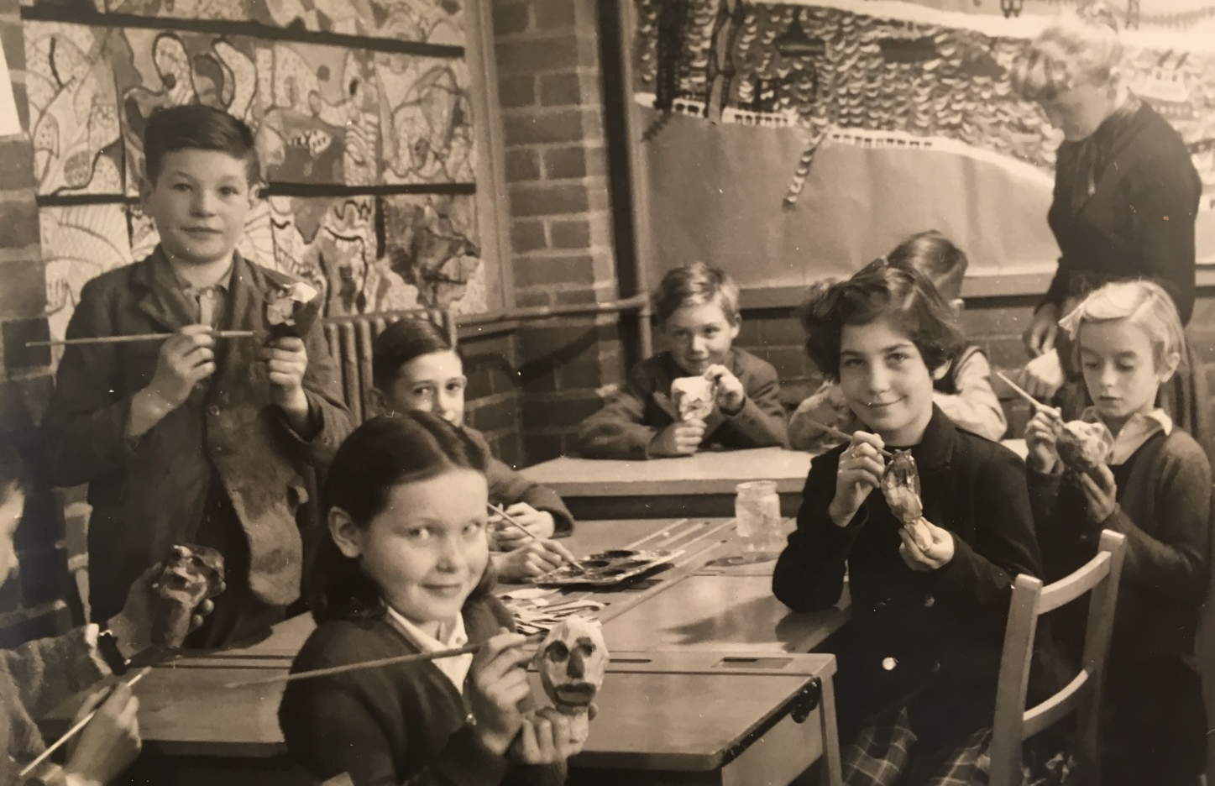
In the beginning …

Slide 29
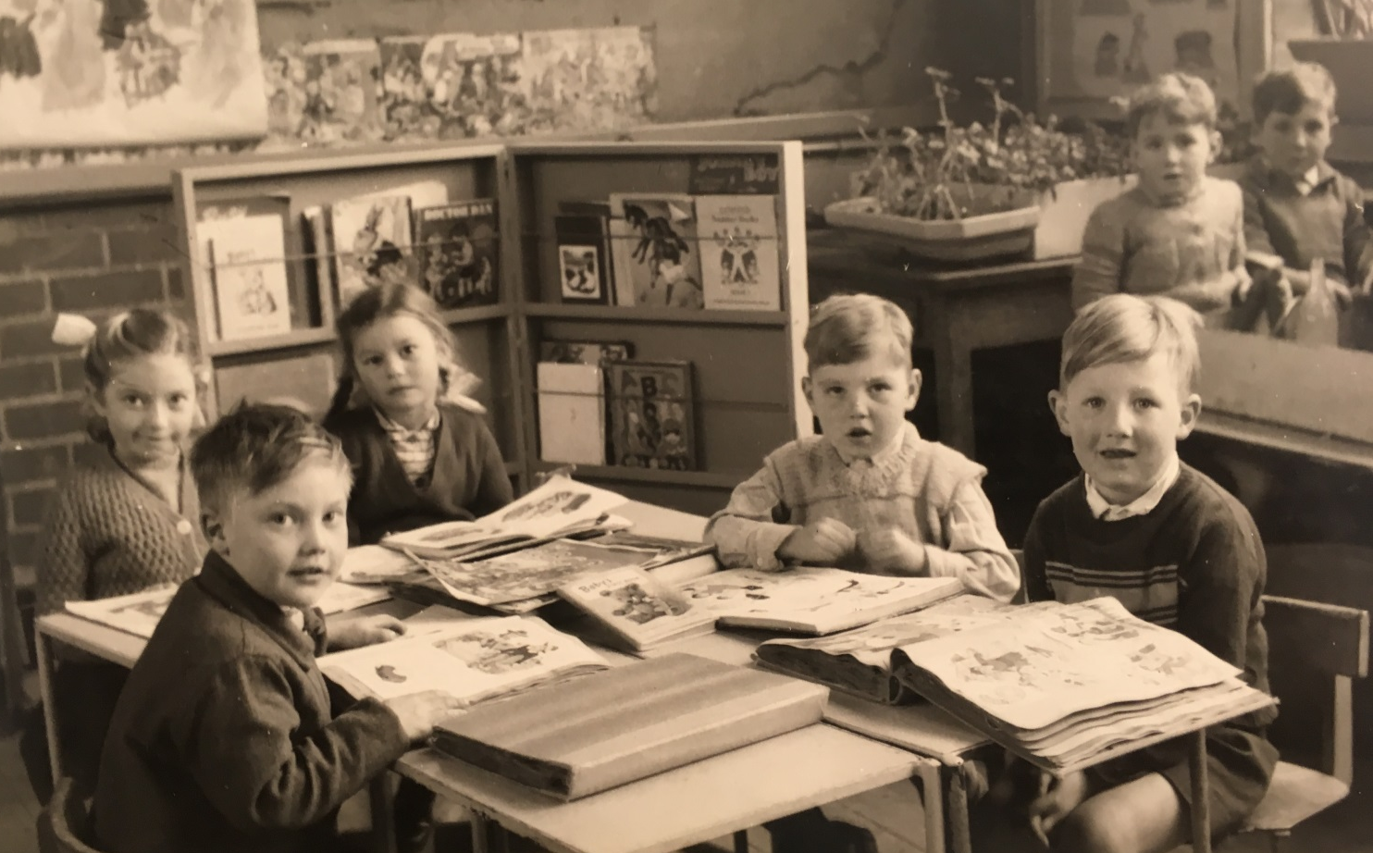
In the beginning …

Slide 30
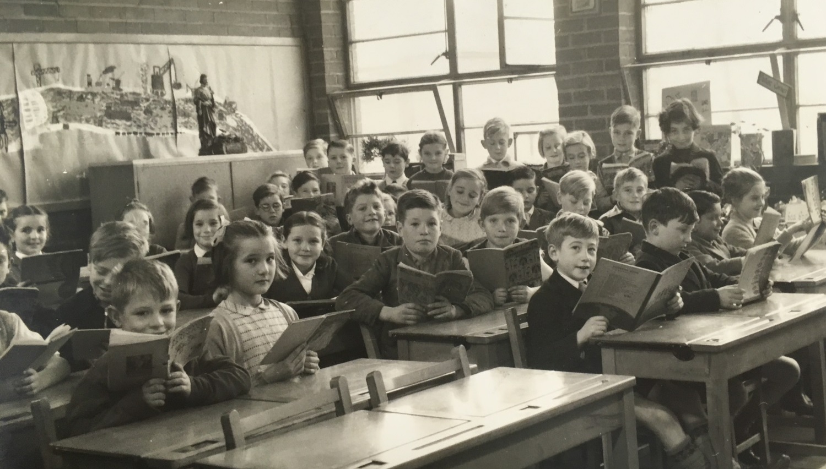
In the beginning …

Slide 31
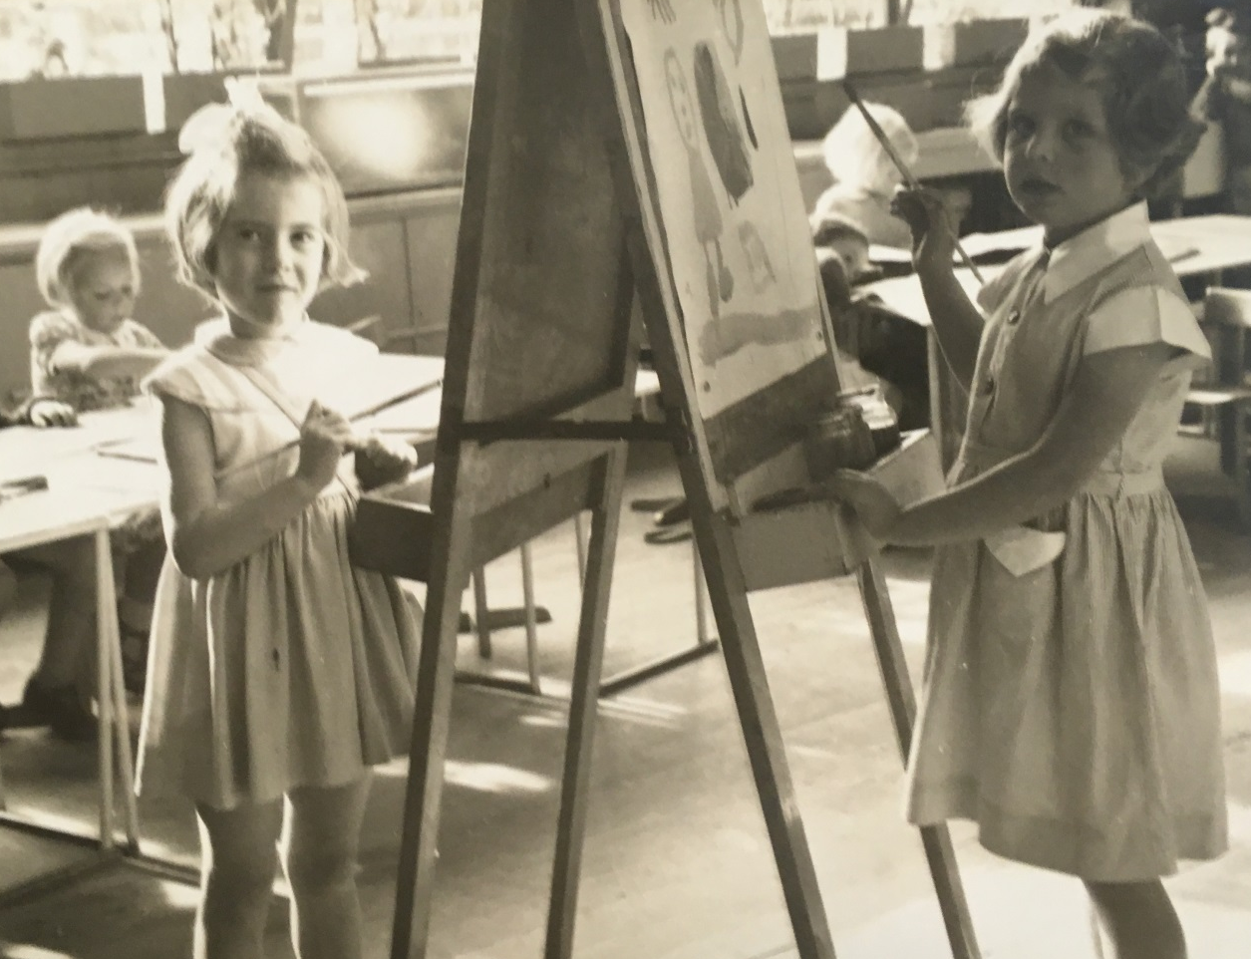
In the beginning …

Slide 32
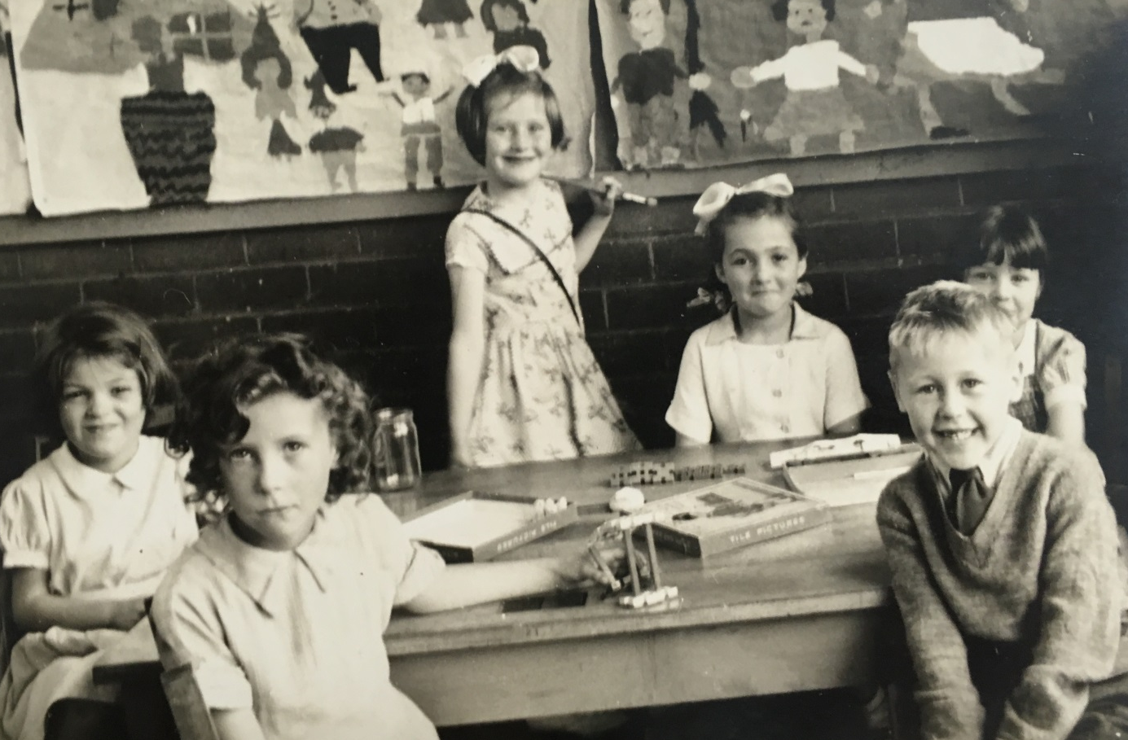
In the beginning …

Slide 33
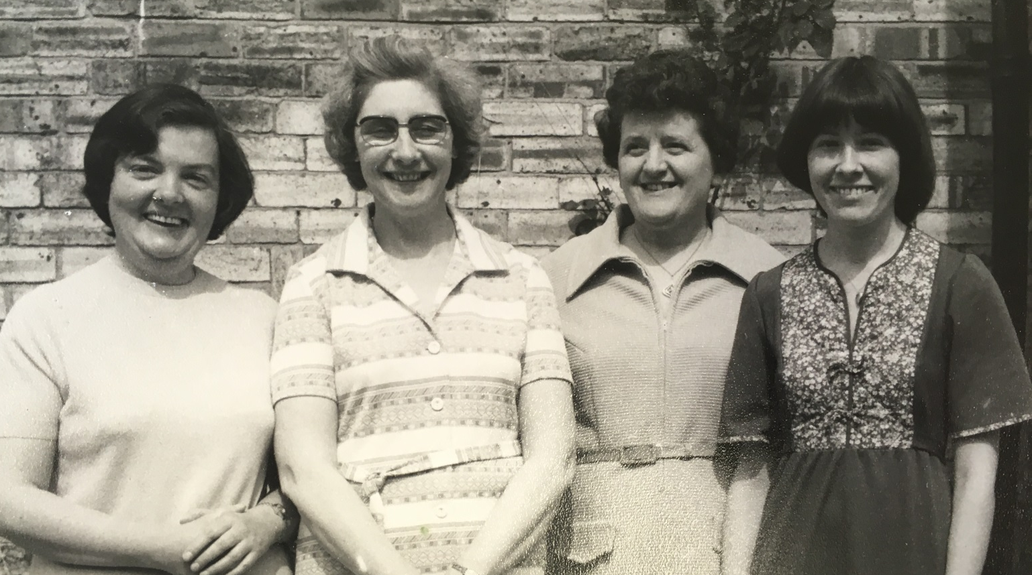
Some of the previous staff …

Slide 34
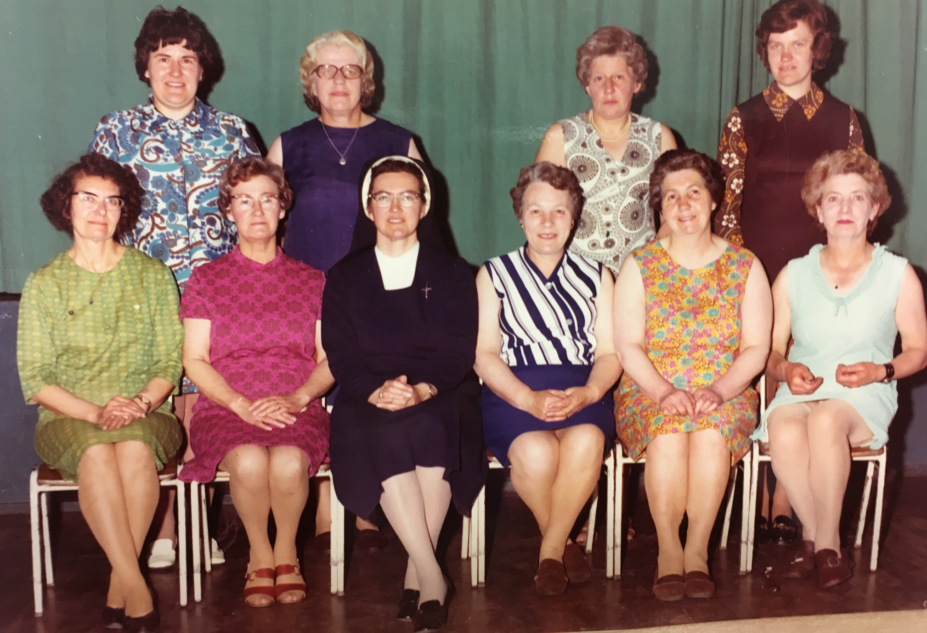
Some of the previous staff …

Slide 35
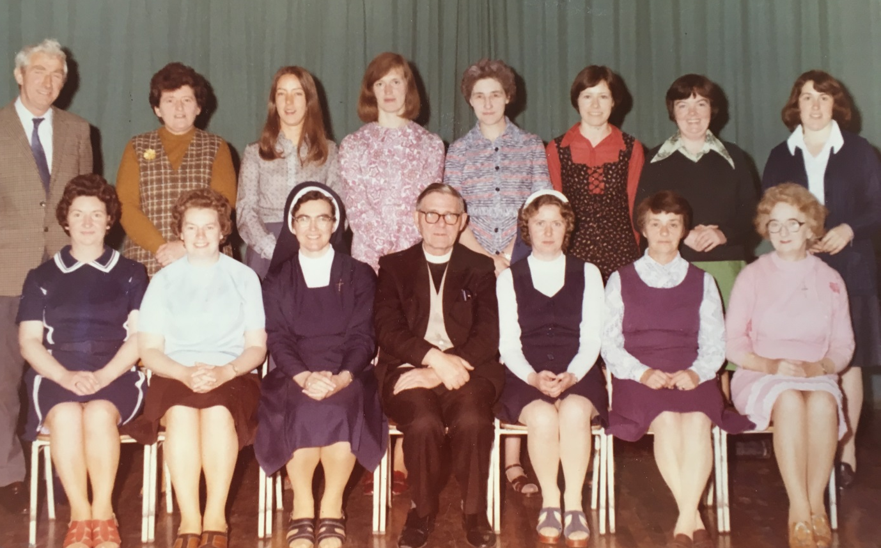
Some of the previous staff …

Slide 36
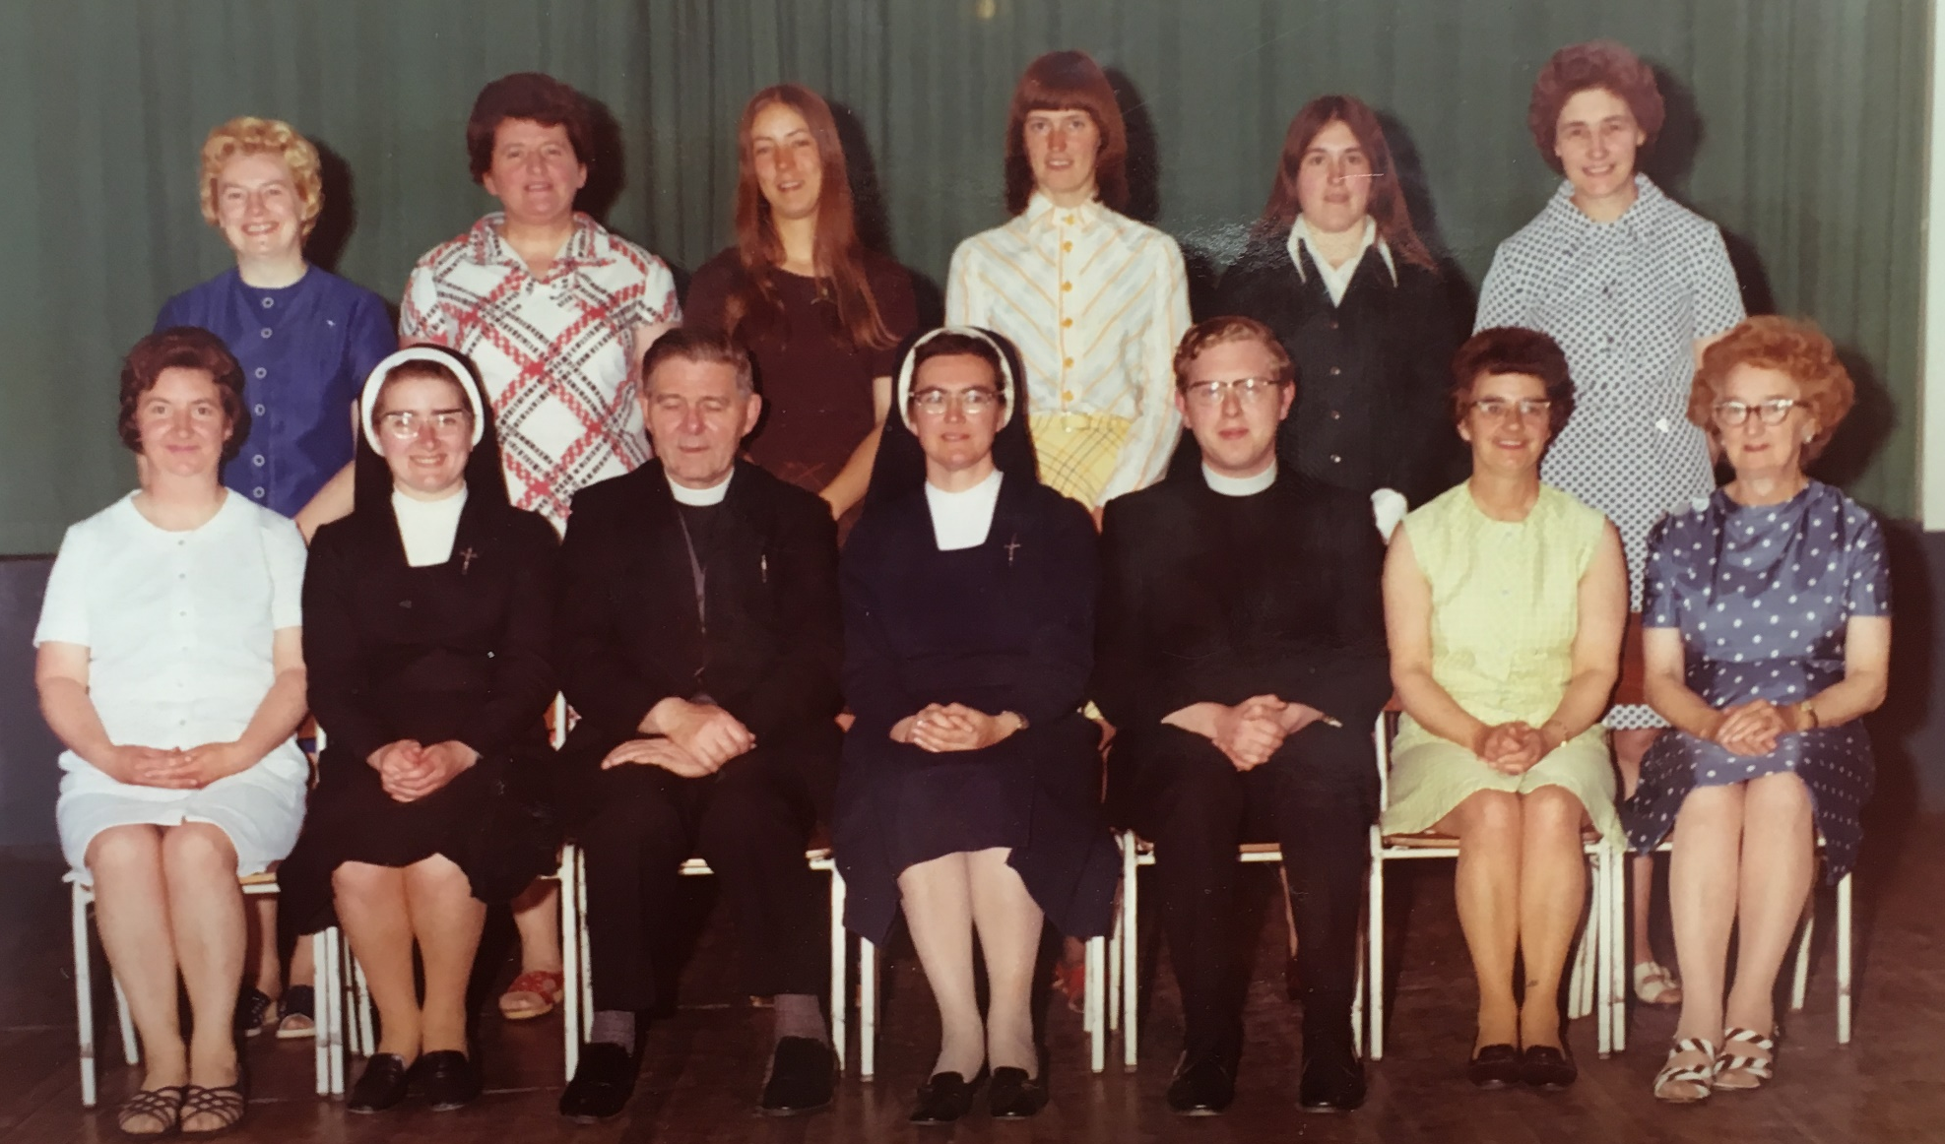
Some of the previous staff …

Slide 37
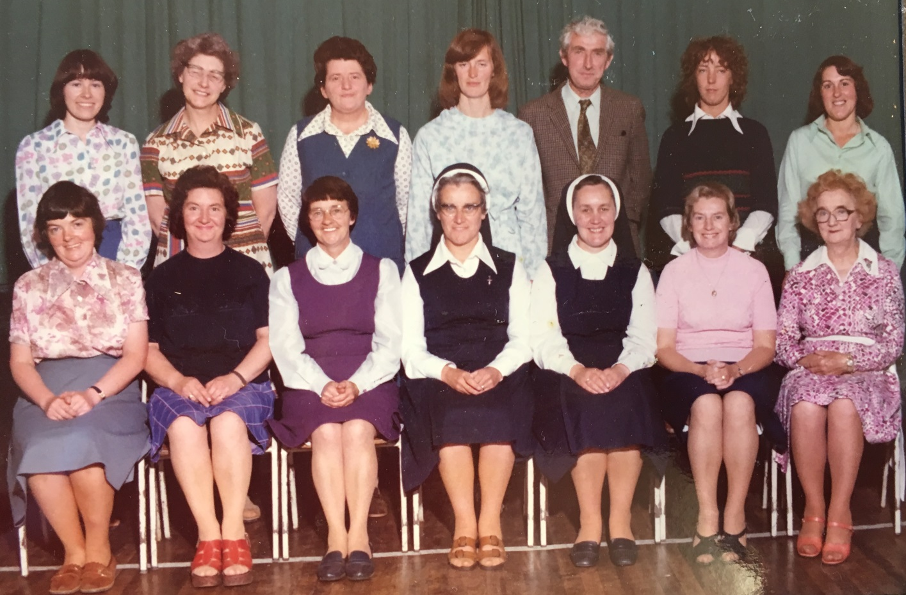
Some of the previous staff …

Slide 38
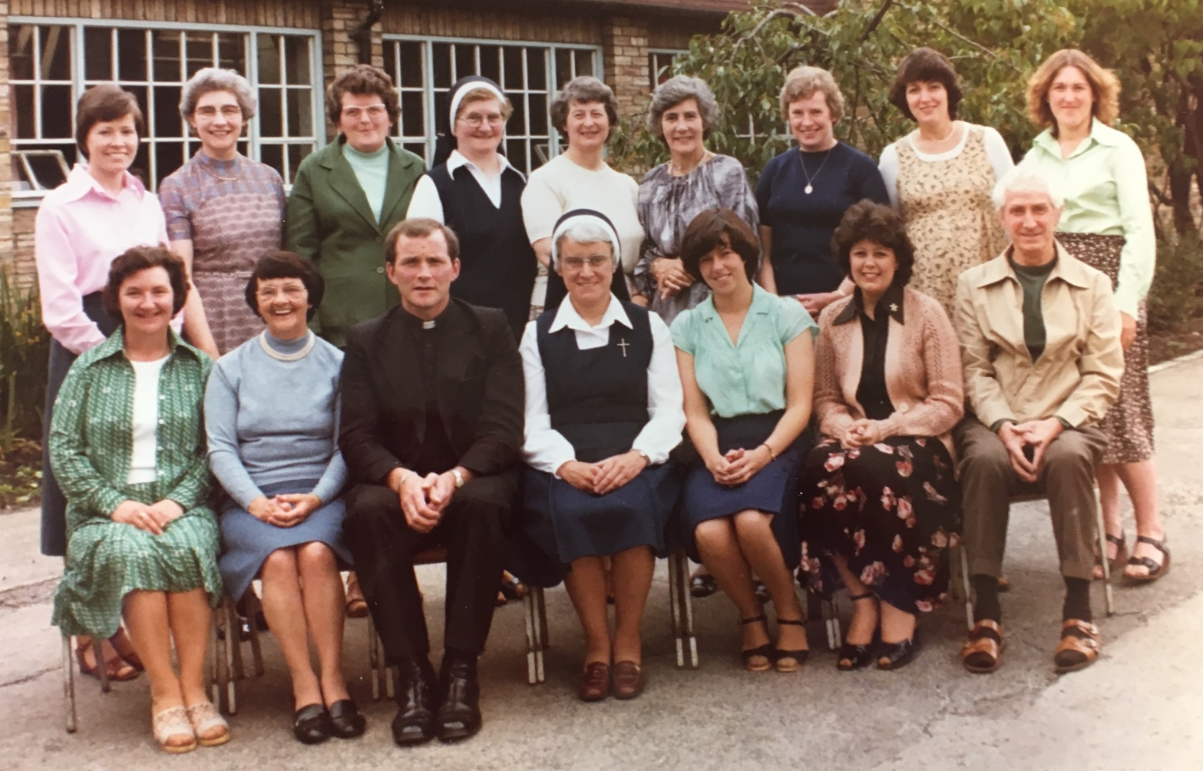
Some of the previous staff …

Slide 39
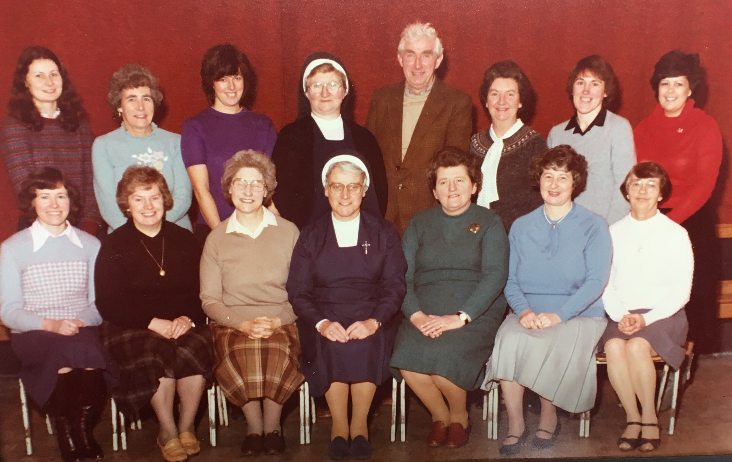
Some of the previous staff …

Slide 40
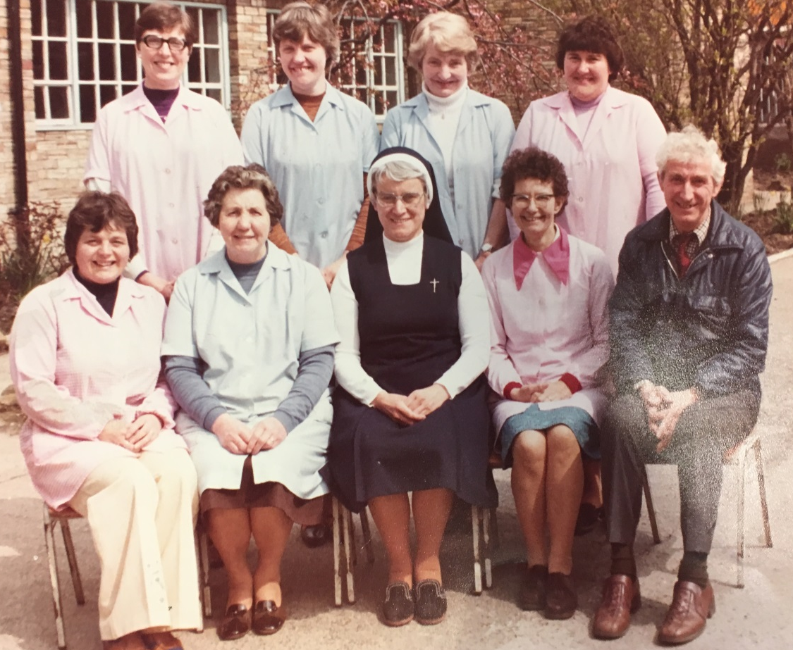
Some of the previous staff …

Slide 41
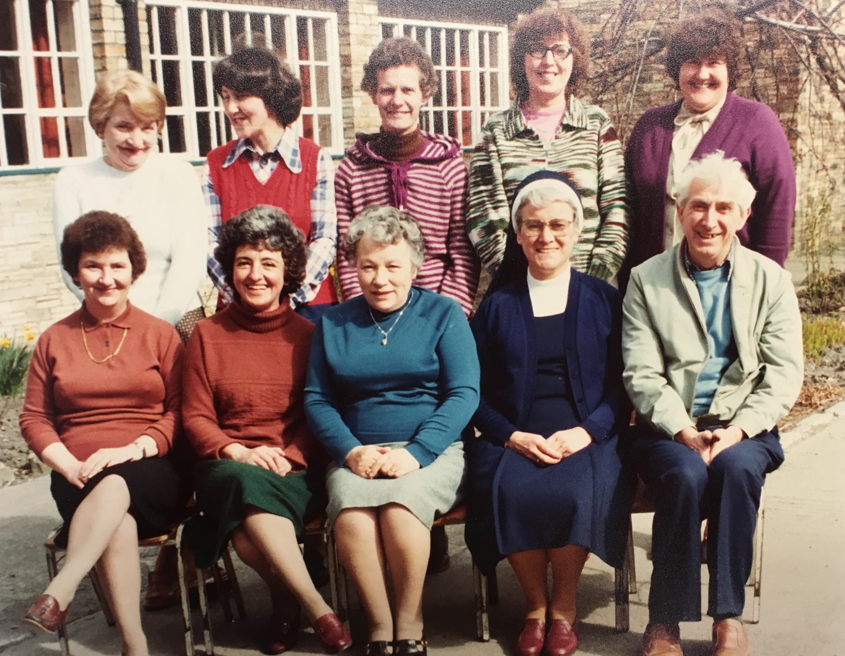
Some of the previous staff …

Slide 42
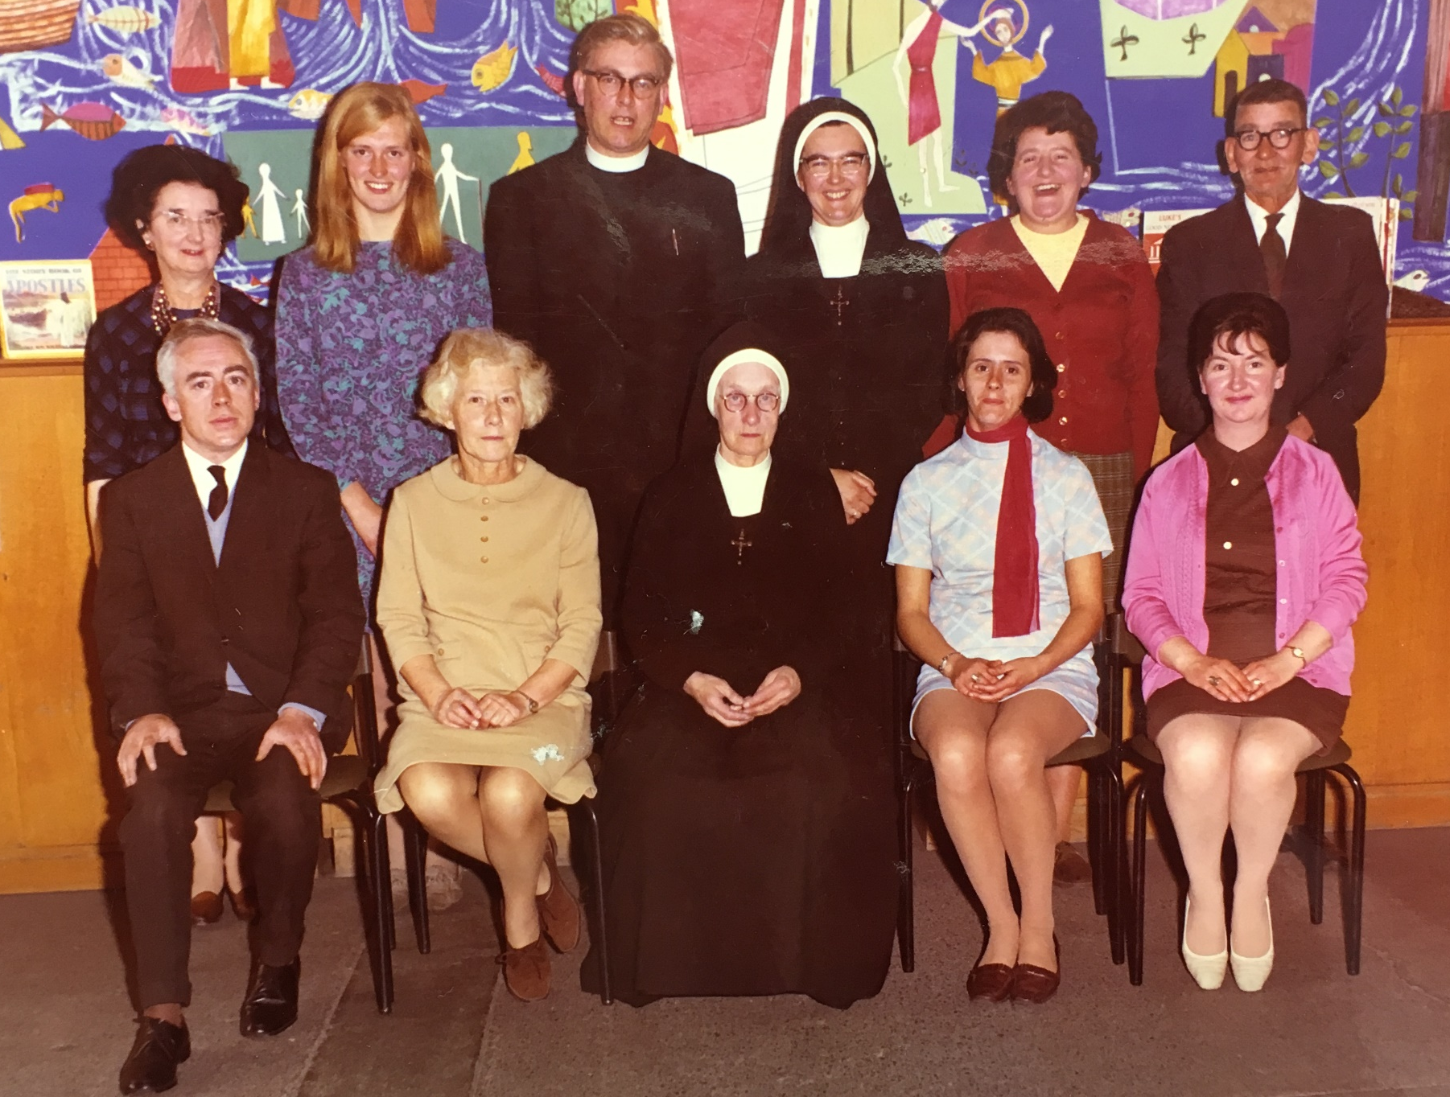
Some of the previous staff …

Slide 43
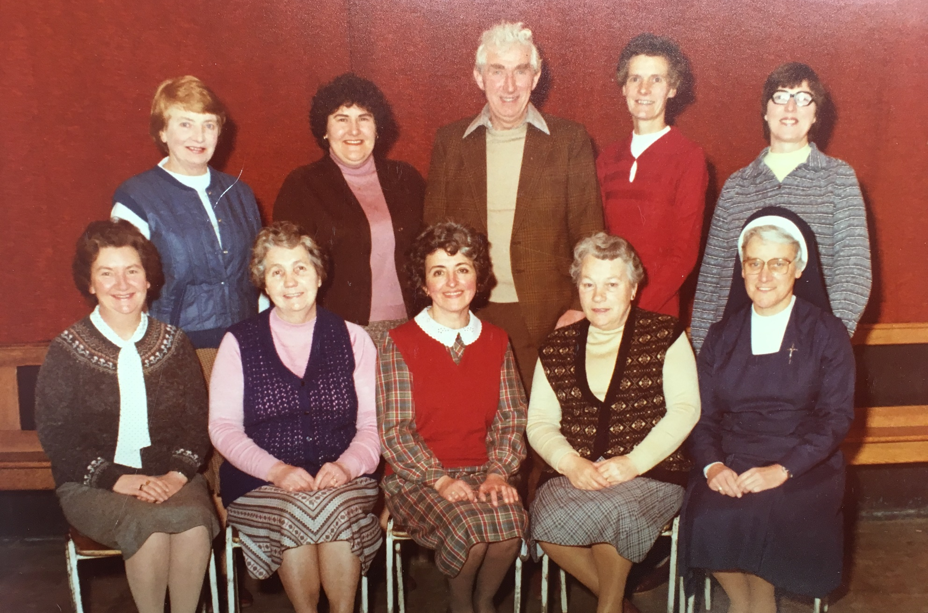
Some of the previous staff …

Slide 44
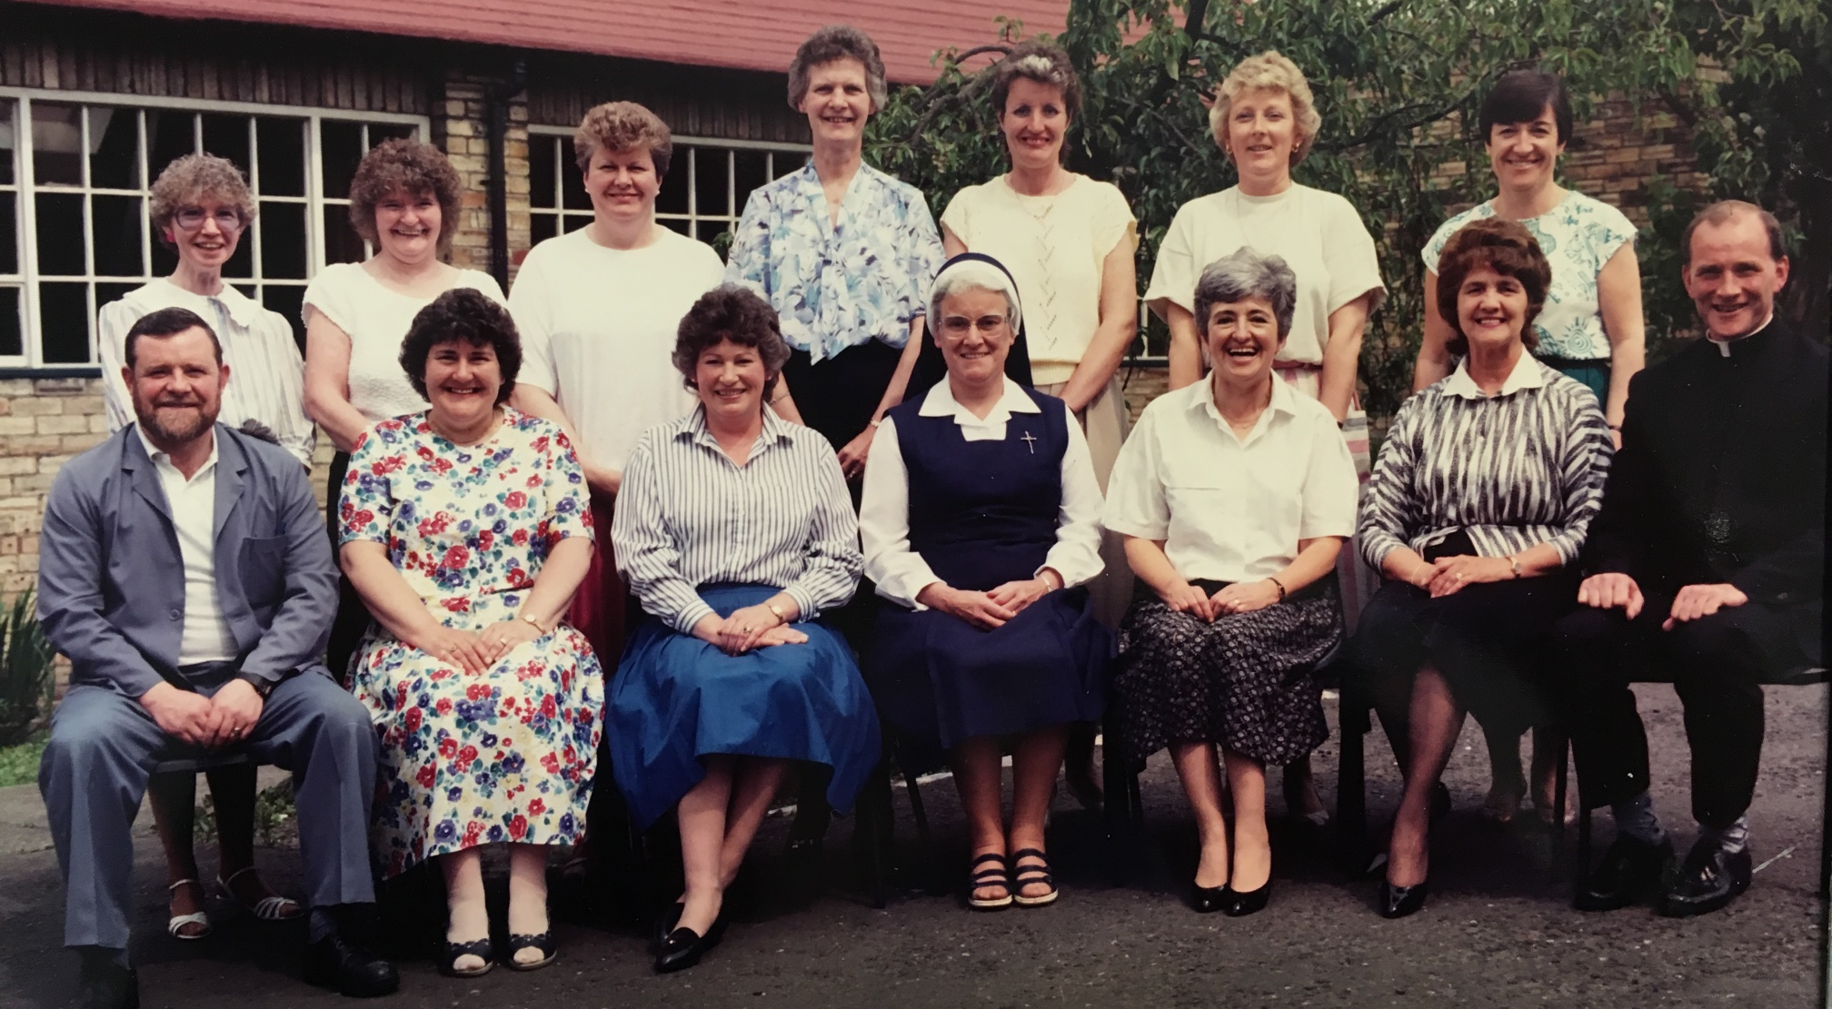
Some of the previous staff …

Slide 45
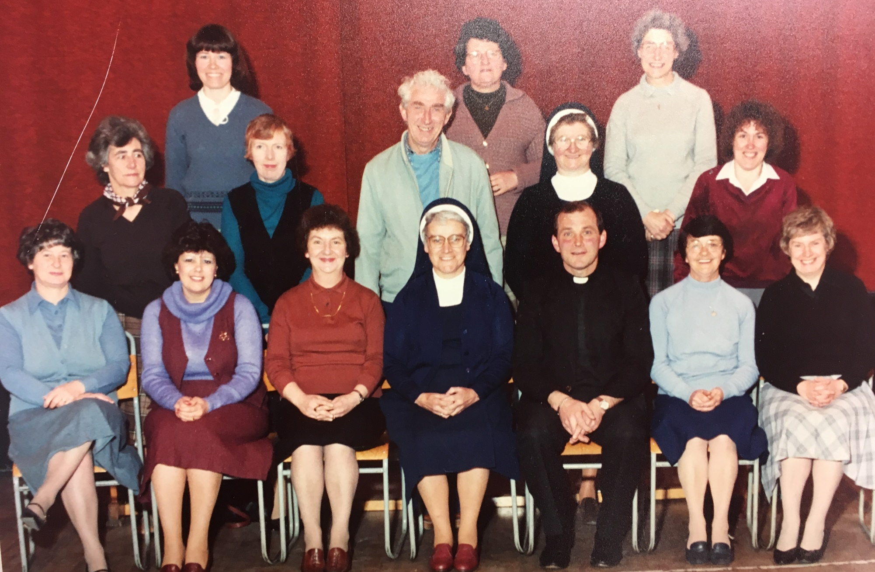
Some of the previous staff …

Slide 46
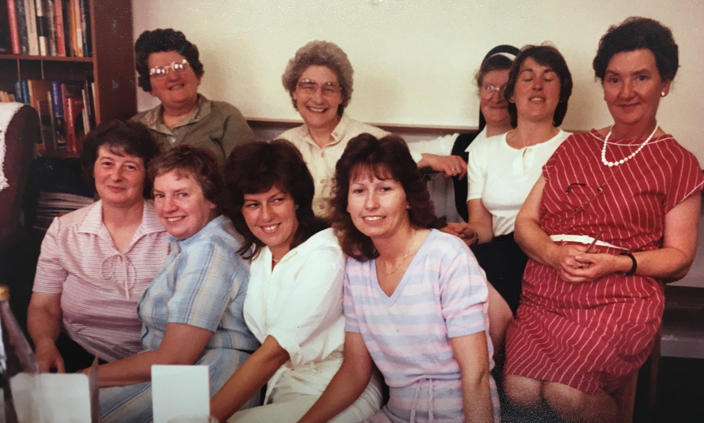
Some of the previous staff …

Slide 47
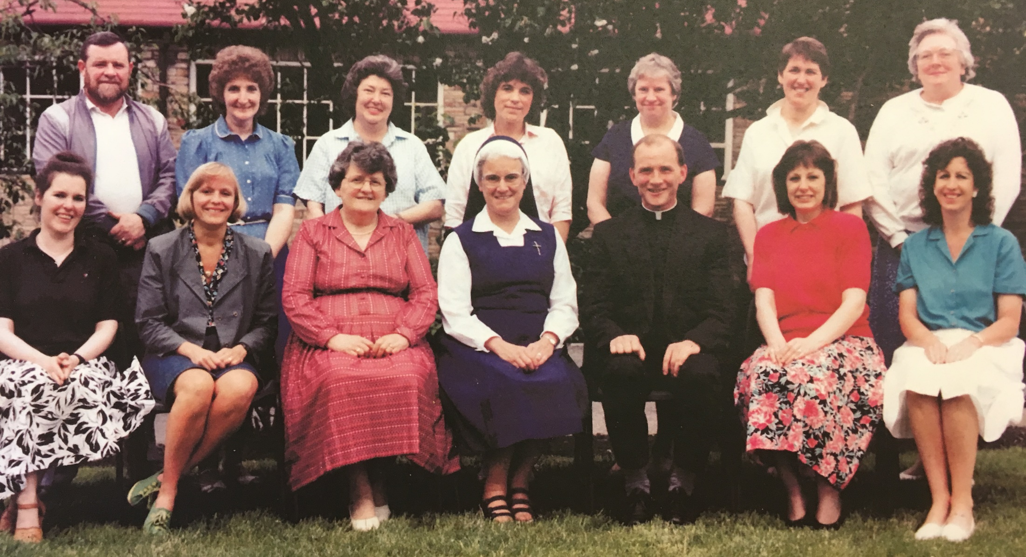
Some of the previous staff …

Slide 48
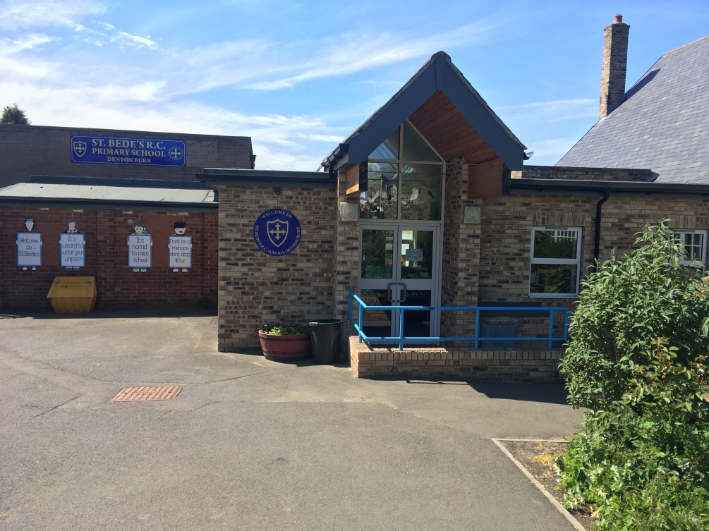
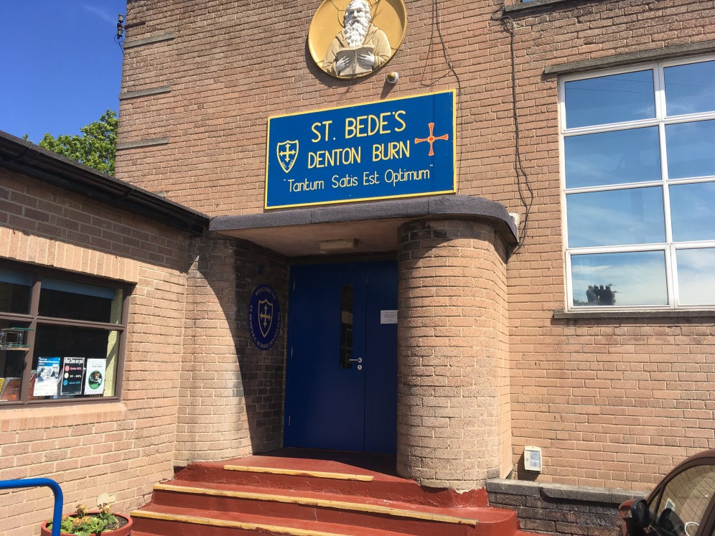
look at st bede’s in our time …

Slide 49
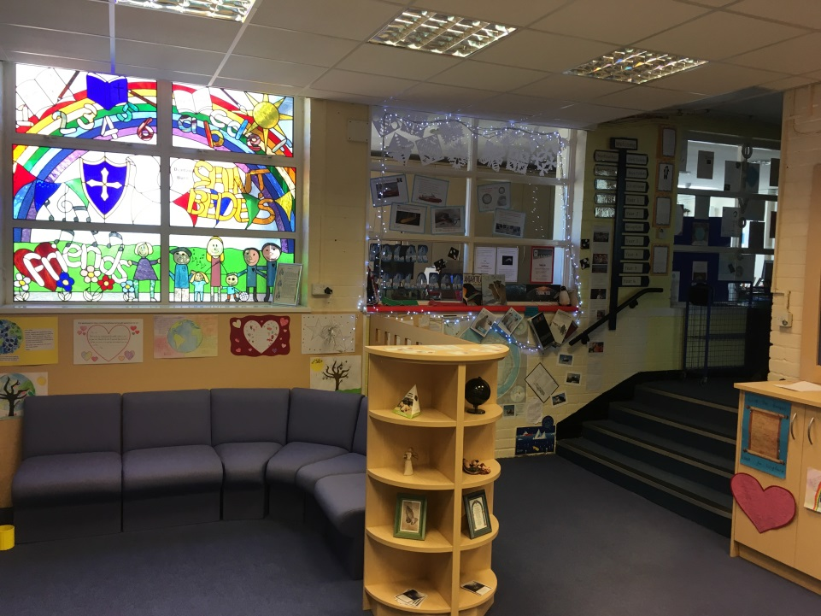
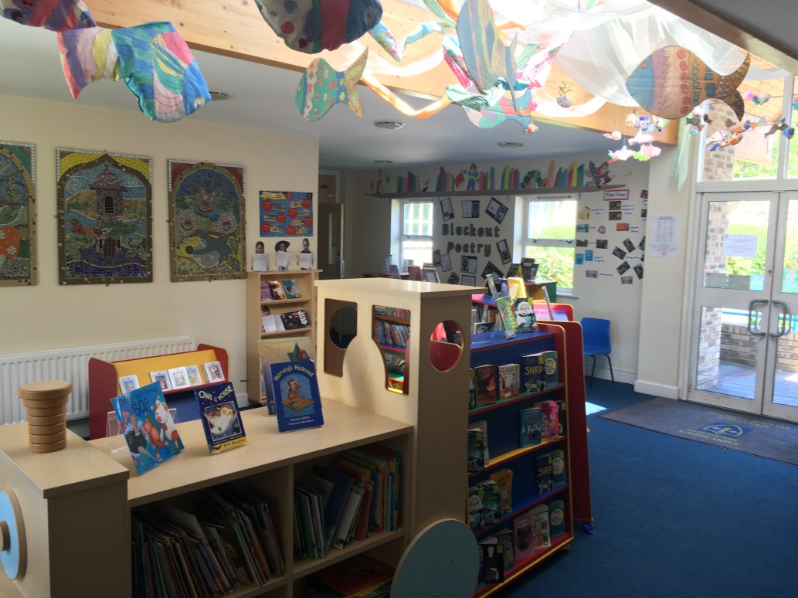
look at st bede’s in our time …

Slide 50
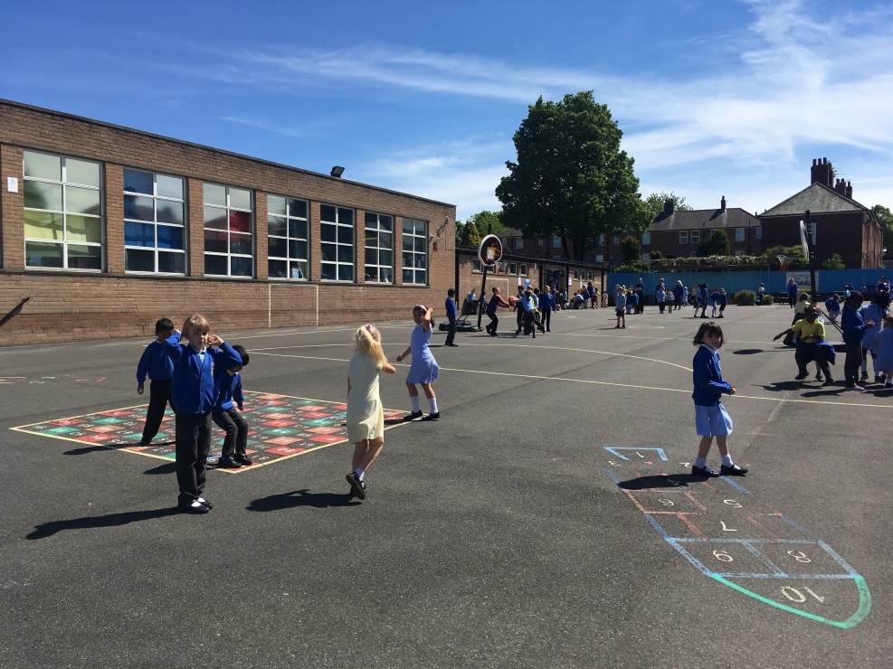
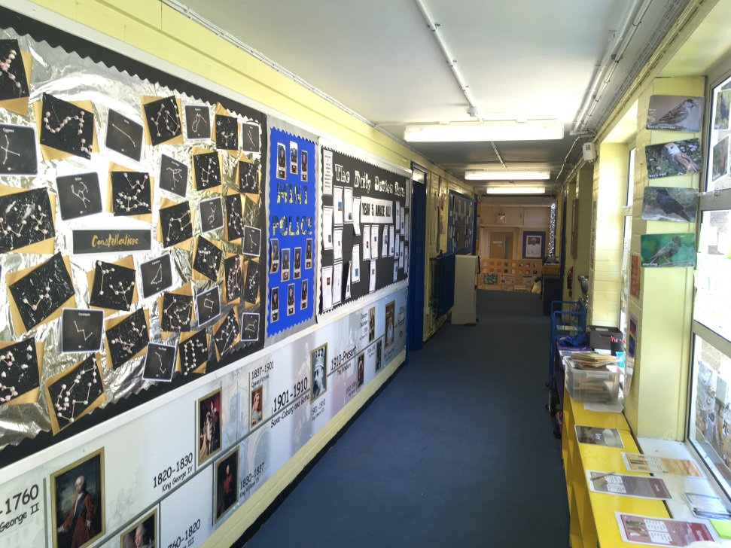
look at st bede’s in our time …

Slide 51
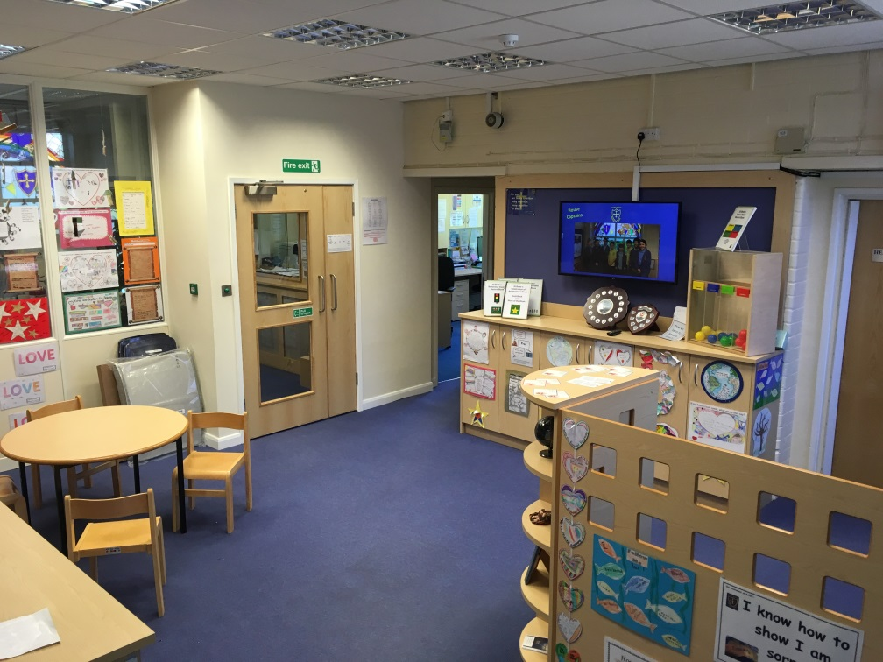
look at st bede’s in our time …

Slide 52
look at st bede’s in our time …

Slide 53
look at st bede’s in our time …

Slide 54
look at st bede’s in our time …

Slide 55
look at st bede’s in our time …

Slide 56
look at st bede’s in our time …

Slide 57
look at st bede’s in our time …

Slide 58
look at st bede’s in our time …

Slide 59
St Bede’s School Song In August 1939, St Bede’s opened its doors, 200 boys and girls destined to walk its floors. World War II was in full swing, a threat to one and all, but unafraid to soldier on…St Bede’s answered its call.

Slide 60
Chorus 80 years of history has passed, Students walking through the doors, their marks ready to cast. Today is just like yesteryear, a friendly welcome beckons, St Bede’s continues strength to strength of that we all do reckon.

Slide 61
So here’s to the next 80 years, may they be filled with joy, Learning new things every day for every girl and boy. Governors, staff and parents too – were all part of the team, Working hard together for our family supreme.

Slide 62
Chorus 80 years of history has passed, Students walking through the doors, their marks ready to cast. Today is just like yesteryear, a friendly welcome beckons, St Bede’s continues strength to strength of that we all do reckon.

